Slide 1
URBAN ENERGY ACCESS TOOLKIT
FOR LOCAL GOVERNMENTS

Slide 2
At COP27, the Global Covenant of Mayors (GCoM)
launched the new Energy Access and Poverty Pillar (EAPP) of its Common Reporting Framework (CRF). To support
the understanding and data sharing in this pillar, GCoM published the report Unlocking Urban Energy Access and Poverty in 2023. This report included analyses of local context, barriers, powers, and solutions – to better understand how local governments could address energy access and poverty (EAP).
Through the research and engagement with Signatories,
it was clear that the analysis was only the starting point to develop a vocabulary and practice around EAP. However,
a further step was needed to effectively support local governments. This Urban Energy Access Toolkit for Local Governments was therefore conceptualised to provide a practical resource for local government staff. The Toolkit aims to enable local government staff and administrations to:
Define the local energy poverty context and energy access challenges using community stories and quantitative data;
Analyse the systemic barriers they experience in implementing EAP interventions; and
Identify pathways to address EAP, such as available powers and influence, suitable interventions, relevant stakeholders, and potential benefits.
It is our hope that the outcomes and impacts of energy access solutions developed by local government staff –
and sharing of best practices and GCoM’s Energy Access and Poverty Pillar (EAPP) indicators – will enable individuals, households and communities to participate more in the economic, social and cultural life of their neighbourhoods.
The modules broadly provide support on EAP data collection consistent with the CRF, as well as defining and developing solutions to EAP. The format and content of the Toolkit, modules and tools are based on stakeholder engagement with signatory officials and the EAPP Subcommittee. Workshops were conducted to understand their key challenges and support needed, as well as to test modules with a range of local governments and contexts.
This Toolkit is created for the use of local government staff; who often lack the resources they need to advocate how EAP affects the citizens they serve, and the solutions to address this deprivation. The tools provided are to help you to start conversations in your own local government; to bring your stories, experiences and ideas together into a dynamic and living action roadmap.

Slide 3

Urban Energy Access Toolkit for local governments
Toolkit Introduction
The modules in this toolkit will help you build
a comprehensive understanding of and plan for addressing Energy Access & Poverty (EAP) within your administrative area, in a way that considers wider benefits of action. Modules can be navigated sequentially or at random, depending on your interests, needs, and your current position.
Each local government is unique, where multiple and diverse departments and staff members may have a role in addressing EAP in your specific context.
This Toolkit is built for local government staff working in EAP, however the tools and guidance in this toolkit could also have value for wider stakeholders.
[Image placeholder]
© Jeroen van de Water, Unsplash

Slide 4
Toolkit module orientation
The Toolkit starts with Module 1 on stakeholders – mapping where the relevant organisations are key
to enable progress on specific energy access interventions or EAP action as a whole.
Modules 2 and 3 explore different types of data.
They come together in module 4 to create your
unique EAP baseline.
Modules 5 and 6 help you develop an understanding of the barriers you may face in addressing EAP, and what powers you have available to tackle these challenges.
Module 7 introduces the different interventions that could be used by local governments to tackle EAP.
Of the interventions introduced in this module, you may select the most appropriate and relevant for you, building on your EAP learnings from Modules 1 to 6.
Finally, Module 8 brings together the previous seven modules to make a case for a specific EAP solution, whilst also highlighting its co-benefits.
The rest of this section presents a more detailed overview of each module.

Slide 5
Module overview
Module 1
Knowing our EAP
stakeholders
Module 2
Stories
as data
Module 3
Mapping available
local data
Module 5
Understanding
local barriers
Module 4
Developing
an EAP baseline
Module 6
Maximising available
city powers
Module 7
Designing EAP interventions
Module 8
Making the case
for Energy
Access

Slide 6
Module overview
Introduction
Introduction
This toolkit begins by introducing what EAP is and defines its three pillars of secure, sustainable, and affordable energy.
It also details the EAP commitments and GCoM signatories’ pledge to report under the Common Reporting Framework, by giving an overview and explanation of the Energy Access and Poverty Pillar (EAPP).
Introduction objectives
Understand what the Common Reporting Framework is and how the EAP pillar fits in the CRF
Understand what EAP is and its three key attributes
Learn how to navigate the toolkit and use the health checks

Slide 7
Module 1 overview
Knowing our EAP stakeholders
Module 1 helps local governments understand key
EAP stakeholders and how they enable the planning of interventions going forwards. In this module, we walk you through how Cape Town in South Africa used mapping and engagement of stakeholders to enable projects and solutions.
The tool in module 1 will guide you to identify who the key stakeholders are, and it will also help you to understand where there may be other stakeholders to consider, and their roles.
Module objectives
Identify which national, regional, municipal and community partners are relevant
Compare groups that are most involved against groups that should be given space to participate and lead interventions

Slide 8
Module 2 overview
Stories as data
Module 2 emphasises that real stories about communities, households and individuals are vital to developing a full picture of EAP in your local government’s context. It explains how qualitative data about “lived experiences” are useful and necessary to define EAP, which can be iteratively refined and used to understand how quantitative data relates to what is happening on the ground.
The tool in this module enables you to identify and document the lived experiences of EAP that city staff and other stakeholders are most aware of in local communities. It suggests how these stories represent qualitative data for both the mandatory and the non-mandatory indicators of the EAPP.
Module objectives
Brainstorm what community stories of
“lived experiences” provide starting points to understand EAP in your local government area
Note where stories indicate important contexts or solutions to be addressed in EAP interventions

Slide 9
Module 3 overview
Mapping available local data
Module 3 explores the importance of collecting and reporting the mandatory and non-mandatory global and regional indicators proposed by the EAPP. This module also discusses the important role of local governments as data owners, and how using data can help the local understanding of EAP. Finally, this module highlights how and why the definition of EAP is contextual and unique for each local government.
The tool in this module will help guide you on how to map what data you have, and how they align with the EAPP’s indicators.
Module objectives
Map what data is useful and crucial to understand, communicate and monitor EAP in your local government area
Understand what quantitative data is and is not available to local governments, and action to collect data

Slide 10
Module 4 overview
Developing an EAP baseline
Module 4 brings the stories, quantitative data, and learning from modules 2 and 3 together – to help you consolidate these into an EAP baseline. The EAP baseline is unique and specific for each local government. It is the first step in enabling the planning of appropriate interventions and solutions for local governments.
The tool in this module will help you to formulate the EAP baseline for your context, based on the stories and quantitative data about EAP in your local government area.
Module objectives
Draft a definition of EAP in your local government area that is easy to
communicate and understand across
a diversity of stakeholders

Slide 11
Module 5 overview
Understanding local barriers
Module 5 explores local governments’ barriers to uncover the complexities they work within, as a starting point to map potential ways forward. This module highlights various categories of barriers to identify opportunities and innovative solutions. These solutions could be found within your administrations, or by collaborating with relevant community, private sector, regional and national stakeholders.
The tool in this module will guide you in identifying the barriers to EAP in your area, and recognise the relationships and interconnectedness between these barriers – including other issues and forms of deprivation in your contexts.
Module objectives
Self-identify what are the key barriers experienced as local government staff in addressing energy poverty or improving energy access
Discuss which of these barriers are obvious and tangible, due to gatekeeping by other actors, and/or narrative blocks around what is possible for residents and communities
Discuss which barriers are interrelated within EAP, or other local issues and forms of deprivation

Slide 12
Module 6 overview
Maximising available city powers
Module 5 – Maximising available city powers
Module 6 highlights the different asset types that related to EAP, where powers are held by your local government. By understanding where different levels of government, utilities, and wider stakeholders hold powers, this module helps local governments maximise available powers and influence to take effective and efficient action.
The tool in this module will enable you to define the unique powers within your context. Rather than framing powers as either “all or nothing”, this tool helps to unpack the nuance and complexity of local governments’ powers.
Module objectives
Self-identify the EAP assets in which local governments have full, shared or no powers to influence policy and implement solutions
Reflect and brainstorm how and where local governments have convening and advocacy powers

Slide 13
Module 7 overview
Designing EAP interventions
Module 7 outlines the five different categories of interventions local governments can employ to improve energy access and reduce energy poverty. This module also highlights the importance of understanding how these different interventions should consider the barriers and power structures a local government has.
The tool in Module 7 will help you to identify which interventions you could use. This includes understanding outcome horizons, the workload of stakeholder collaboration, and the degree of local government powers needed in most cases. It will also guide you in how to split your chosen interventions down into smaller, more actionable steps.
Module objectives
Reflect on your local government’s appetite for specific interventions based on time horizon, current capacity, and powers available
Self-identify which interventions are prioritised and suitable for your local government and residents
Detail interventions and break them down into smaller steps

Slide 14
Module 8 overview
Making the case for Energy Access
Module 8 brings together the previous seven modules to consolidate the available information and create momentum for action. The ability to consolidate this information is crucial to support effective and efficient advocacy, as well as planning and funding applications. Additionally, this module recommends synergies with other climate actions and co-benefits.
This tool provides a co-benefits matrix of the interventions outlined in module 6. It also provides a worksheet to bring together your understanding and knowledge from all the modules to make your case for EAP interventions in your context.
Module objectives
Enable cities to make the case for a suite of interventions based on communities’ lived experience

Slide 15
Introduction

Slide 16
Introduction
Toolkit Introduction
Introduction objectives
Understand what the Common Reporting Framework (CRF) is and how the EAP Pillar
fits in the CRF
Understand what EAP is and its three key attributes
Learn how to navigate the toolkit and use the health checks
Other useful resources
EU Commission’s Energy Poverty Advisory Hub (EPAH) training course
Theme report on energy access by the United Nations Technical Working Group on Energy Access
This module sets the scene on the importance of local governments in addressing energy access and poverty. This module also introduces what EAP is and defines its three pillars of secure, sustainable, and affordable energy. It will also establish what it means for GCoM signatories to pledge for EAP by giving an overview and explanation of the Common Reporting Framework (CRF).

Slide 17
The potential of local governments
Toolkit Introduction
Local governments are central to improving energy access
Cities and local government work the closest to communities, households, and individuals who are experiencing energy poverty.
Local governments have a deep understanding of how people interact with energy suppliers, infrastructure,
and tariffs in their operations and services. They can identify local expressions of energy poverty that arise from individuals’ socioeconomic and cultural identities, contexts, and challenges.
Responding to local needs and priorities
With their ownership and understanding of data,
and their closeness to local contexts, stories, and lived experiences, local governments are in a unique position to design innovative and effective energy access solutions.
By combining their vision with contextual data, they can create targeted interventions that address real-life challenges. This approach also presents an opportunity to co-produce knowledge, technical skills, and benefits for a diverse range of city stakeholders.
Finally, it balances the ownership of action, instead of solely relying on local governments’ policies and infrastructure or individual energy consumption choices.

Slide 18
Common Reporting Framework (CRF)
Toolkit Introduction
GCoM’s Common Reporting Framework (CRF) brings together local data, actions, and voices and raises the bar on a transparent, robust evidence base that amplifies the impact of local government climate action.
These recommendations streamline measurement and reporting procedures, ensure robust climate action planning, implementation and monitoring, and retain the flexibility needed to meet local and regional contexts.
Within the CRF, local governments prepare and submit an energy access and energy poverty assessment within two years after committing to the GCoM, considering the three attributes of secure, sustainable and affordable energy.
Energy Poverty and Access integration into the Common Reporting Framework
EAP Assessment
Secure energy
Affordable energy
Sustainable energy
EAP Targets
Climate Action and Energy Access Plan(s)
Monitoring and reporting
Notes:
Matilde

Slide 19
Energy Poverty and Access Pillar (EAPP)
Toolkit Introduction
Energy poverty is a direct expression of deprivation in a city’s every-day life with both context
and impact experienced by individuals, households, and communities.
The energy access and energy poverty pillar (EAPP) is an integral part of the journey of local government towards a more sustainable future. Therefore, strategies and measures undertaken by local governments can simultaneously address more than one pillar (i.e. climate change mitigation, adaptation and energy access/poverty).
GCoM signatories pledge to implement policies that facilitate energy access and/or reduce energy poverty and shall undertake measures to:
Contribute to achieve SDG7 by ensuring access to affordable, reliable, sustainable and modern energy for all;
Contribute to increase the level of energy access
within the boundary of context;
Contribute to reduce energy poverty within
the boundary of context; and
Track progress toward these objectives.
Notes:
Matilde

Slide 20
EAPP definitions
Toolkit Introduction
Secure Energy
Sustainable Energy
Affordable Energy
The three attributes assessed under the CRF of the EAPP are secure, sustainable and affordable energy.
These three categories assess the energy access and energy poverty conditions of local governments.
Definition
Energy is accessible and/or reliable—enabling access to economic, social and cultural engagement
Energy is generated from renewable and non-pollutive resources—avoiding negative health, social and gender consequences
Energy is affordable and/or building stock is energy efficient to maximise value of expenditure—enabling energy applications for economic, social and cultural opportunities
EAPP CRF targets
Increase average duration of available electricity
Increase percentage of population or households with electricity access
Improve annual average energy consumption per capita, without affecting the level and quality of use
Increase installed renewables capacity
Increase total renewable energy generation
Increase renewable energy consumption
Transition source mix of energy for heating & cooling
Reduce percentage of population or households that face energy poverty
Increase building energy efficiency
Notes:
Matilde

Slide 21

Opportunities with emissions reduction, climate resilience and social equity
Toolkit Introduction
Insecure, unsustainable and unaffordable energy access could have overlapping challenges with emissions, climate risks and socioeconomic inequality. Different local governments have various structures and understandings that could lead to EAP being addressed separately or combined with wider climate goals.
Considering the lack of data in many local governments, this overlap is an opportunity to identify where data can be shared.
This is also an opportunity to implement solutions that address multiple challenges – sharing and maximising limited resources across departments.
© Francisco Kemeny, Unsplash

Slide 22
Understanding EAP assets
Toolkit Introduction
In the context of EAP, the term “assets” is used to describe the technological, infrastructural and economic conditions that impact energy access and poverty alleviation.
Assets can be categorised into three main groups, based on their functions:
Energy generation
Energy transmission and distribution
Energy consumption
Throughout this toolkit we use assets as a framework to explore the barriers, powers, interventions, and stakeholders to help you better understand EAP in your context.
The next two pages present specific assets within the three main groups of generation, transmission and distribution, and consumption. They are arranged in three main groups:
Assets related to upstream generation, transmission, and distribution
Assets at the local government district and neighbourhood level
Assets at the building level

Slide 23













EAP asset types
Upstream generation and distribution
Toolkit Introduction
Energy source procurement
Non-renewable
energy generation
Local government districts and neighbourhoods
Solar
Power transmission
Power
distribution
Hydro
Geothermal
Energy
storage
District heat/cooling generation
Wind

Slide 24








EAP asset types
District and neighbourhood scale
Toolkit Introduction
Residential
and commercial
buildings
Micro-grid solutions
Energy efficient
building stock
Energy
storage
Distributed solar
generation
Low carbon
heating and cooling
Clean cooking equipment and fuels
Back-up energy generation
Local government districts and neighbourhoods

Slide 25
How to use this Toolkit
Using modules and tools
Toolkit Introduction
Module content
Each module in this toolkit begins by presenting the context and the content of the module. The content draws on the concepts and language around EAP
from GCoM's 2023 research, presented in a way
that unpacks your experiences as local government officers and builds your next steps.
Each module also closes with a "health-check worksheet". It will review if you have met the modules' objectives, by providing space to consolidate your EAP learning and reflections that are specific to your local government
Using the tools
Each module contains a tool for EAP planning and discussion. The tools have been designed to guide
and support you to put into practice what you have learnt in the module.
Each tool has been developed to support you in
your unique EAP journey, taking into consideration
your specific contexts. There is no specific order in which you must complete the tools – they are there
to support you at your own pace. However, we have provided instructions for each tool, suggesting:
when it is an appropriate time to complete the tool;
who should be involved in the process;
recommended “set ups”, for example some tools contain links to digital databases while others we suggest completing as worksheets (either printed
or on a digital whiteboard).
Notes:
Laurie
Giving them a big picture – definitions
Navigation tool

Slide 26
How to use this Toolkit
Tool & facilitation guides
Toolkit Introduction
The worksheets and tools in every module are also accompanied by guides that provide steps and suggestions.
This includes two types of notes, as demonstrated below: step bubbles to describe what should be done in the
worksheet, and facilitator or user notes.
Worksheet
Step bubbles
To explain what is to be done in a part of a worksheet
Facilitator notes
User notes, facilitation ideas
and examples

Slide 27
Toolkit Introduction
How to use this Toolkit
Health-check worksheets
At the end of each module, there is a health-check worksheet. These review the module objectives to consolidate what you have learnt about your local EAP context in the module.
Together, the worksheets will form a folio of EAP knowledge that you will be able to use for easy reference.
Here is an example of what the health-check worksheets look like.
Cities can also use the health-check prompts for other formats of engagement. E.g. online collaborative brainstorming via Miro and Google Jamboard, as well as online poll platforms such as Slido and Mentimeter.
Reflection question related to module objective
Space to note reflections individually
or as a facilitated group
Reflection question related to module objective
Reflection question related to module objective
Notes:
Laurie
References folder, ICA tool
End of every module chapter checkboxes to say yes/no
How to use healthcheck worksheet
For every module, have you achieved the objectives set out on P1? Are you working towards objective C? Box for them to write their findings – folio of all EAP engagement form all health checks and that’s module C

Slide 28
Module 1
Knowing your
EAP stakeholders

Slide 29
Knowing your
EAP stakeholders
Module 1 – Knowing our EAP stakeholders
Who is at the decision-making table?
Stakeholders beyond local government play a crucial role in facilitating energy access and alleviating energy poverty.
National, regional, municipal, and community stakeholders have different roles in advancing
energy access and tackling energy poverty.
Understanding this specific aspect of EAP enables
local governments to develop your plans in a contextualised way.
Module objectives
Identify which national, regional, municipal and community partners are relevant to strategic planning or delivering EAP interventions
Compare groups that are most involved against groups that should be given space to participate and lead interventions/solutions
Other useful resources
C40 Cities’ Inclusive Climate Action playbooks
Notes:
Module introduction content
Discussion of how understanding the specific context of EAP in a city enables the planning of levers and solutions going forwards
Who is involved in different assets
Giving an example? – very contextual and dependent on what energy access and governance looks like in your city – depends on the levers are you are interested in
- cape town case study

Slide 30

Who is included in decision-making?
Module 1 – Knowing our EAP stakeholders
Knowing who key stakeholders are for an intervention, and how they can be engaged with is key to responding to EAP in meaningful and effective ways.
Engaging with community organisations representing groups who experience energy poverty – or lack of energy access – enables interventions to respond to local contexts. These specific needs and challenges may not be captured in reporting and quantitative data.
Private sector and non-profit stakeholders are also key. You can ensure that actions are technologically feasible by consulting solution providers. These engagements can also boost implementation via financing projects and research.
Finally, national and local government colleagues across departments and agencies are helpful to find opportunities to synchronise projects and funding to ensure delivery of EAP solutions.
© Sulthan Auliya, Unsplash

Slide 31
EAP stakeholders in Cape Town
Module 1 – Knowing our EAP stakeholders
Cape Town is a port city of 4.6 million residents,
where the majority are connected to licensed electricity suppliers. However, there are at least 70,000 informal households without direct grid connection, and more accessing electricity as informal “backyarders”.
To advance various projects and solutions, city staff needed to identify the relevant stakeholders.
For example, Eskom, a state-owned utility in South Africa, operates most power generation assets in the country. Despite the City of Cape Town having limited influence over Eskom’s policies and infrastructure,
the City challenged Eskom’s exclusive rights in court
in 2019.
Subsequently, an amendment to the Electricity Regulation Act (2006) allowed municipalities to
procure electricity from private sector energy developers. As a result, the City of Cape Town
launched a tender to acquire 300 MW of renewable power from independent power producers (IPPs).
This move aimed to reduce reliance on Eskom and mitigate load-shedding, ultimately improving access
to more affordable, reliable, and sustainable energy.
Notes:
City staff has varying power over the different local community, governmental and private stakeholders and must thus use the power they do have to their advantage.

Slide 32
Cape Town interventions and stakeholders
Module 1 – Knowing our EAP stakeholders
Each local government will have its distinct chosen interventions with different stakeholders involved. In Cape Town, the municipality co-designed interventions with stakeholders listed below:
Solutions | Renewable energy procurement | Small Scale Embedded Generation (SSEG) scheme | Free Basic Alternative Energy policy (under development) | City of Cape Town Low-income Energy Services (LINES) unit | Municipal Energy Resilience (MER) Initiative
Intervention type | Establish legal and regulatory frameworks to implement interventions with private sector participation | Establish legal and regulatory frameworks to implement interventions with private sector participation | Policy and programme design that speaks to lived experiences that deliver socioeconomic benefits | Central working group for energy access to lead ownership, coordination, and stakeholder engagement | Joining regional and international platforms to share best practices, develop solutions, and form advocacy coalitions
Stakeholders | City of Cape Town Eskom | City of Cape Town Independent Power Producers | City of Cape Town Households Municipalities | City of Cape Town Low-income Energy Services (LINES) | City of Cape Town Independent Power Producers

Slide 33



EAP governance
Module 1 – Knowing our EAP stakeholders
In the development of this Toolkit, many cities shared that a common challenge for local governments is a lack of clear ownership for EAP.
A clear EAP team that is empowered to collect data, engage with stakeholders and plan interventions is the most important starting point. Without this, local government officials will encounter barriers in discussing how EAP is a challenge for citizens.
Some potential EAP governance configurations are presented on this page. None of these are superior
as contextual starting points for leadership on energy access. From here, EAP teams can start to plan
how to navigate local government and national political structures to deliver EAP planning and interventions.
Examples of EAP governance configurations
in local governments
 | EAP team and/or officers within a specific department (e.g. social equity and support, energy policy and infrastructure, housing provision and quality, etc.)
 | Energy Access Working Group with representatives from multiple departments
 | Individual officers with EAP-related roles across multiple departments

Slide 34
Stakeholder mapping tool
Module 1 – Knowing our EAP stakeholders
This tool will help you identify who the stakeholders
are for various EAP assets that you would like to focus on. The worksheets in this tool can be copied and completed multiple times, depending on the specific focus needed.
Engaging with key stakeholders can help you to design and implement more impactful solutions. Collaborating with stakeholders also fills gaps in available local government powers (Module 6).
When you are ready to select and act on priority interventions (Module 7), this guidance and worksheets can be reviewed to narrow down key stakeholders.
When to use this Tool
Use this tool when you are ready to map the constellation of stakeholders who you can draw on for insights about energy access and poverty, and/or collaborate with in shaping and delivering interventions.
Who should be part of the conversation
Local government staff who understand the interventions you are interested in exploring.
Suggested set-up and logistics
The following pages can be printed and used to centre discussions and conversations.
Notes:
Laurie

Slide 35
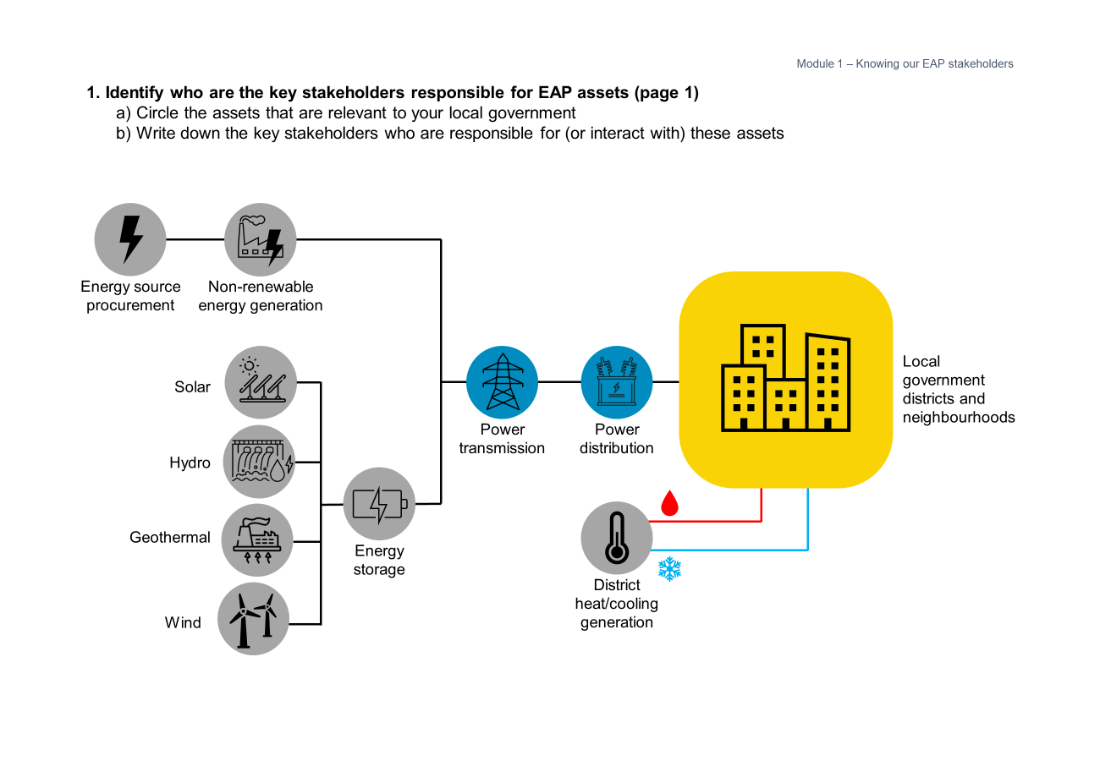
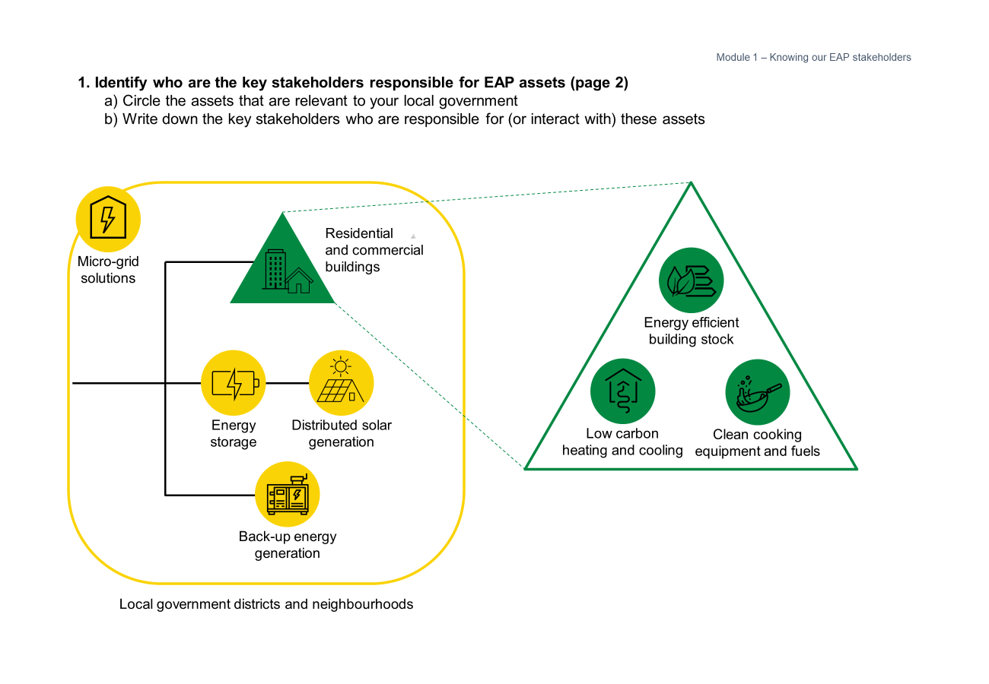
Tool & facilitation guide
Stakeholder identification
Module 1 – Knowing our EAP stakeholders
1
Circle the EAP assets that the team would like to focus on
Facilitator notes
Key stakeholders could include organisations responsible for these assets, and communities that interact often with these systems
2
Using sticky notes,
write down the key stakeholders for these assets

Slide 36
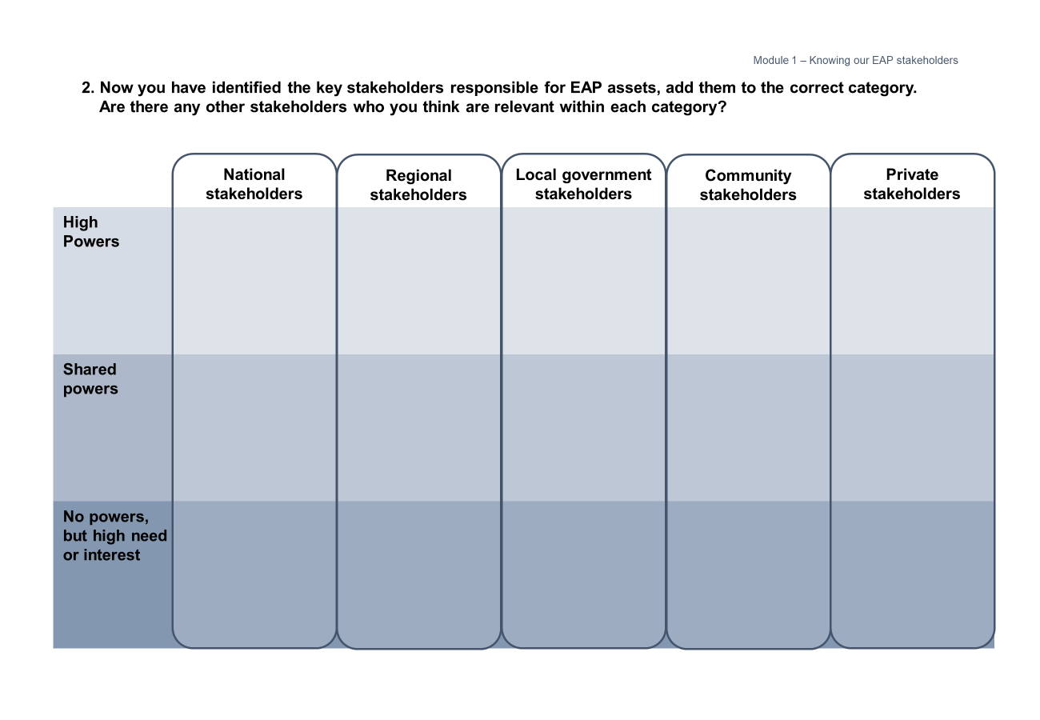
Tool & facilitation guide
Mapping stakeholders
Module 1 – Knowing our EAP stakeholders
1
Place the sticky note based on what degree of power EAP stakeholders have in your city.
Facilitator notes
Within each relevant stakeholder group, there can be varying degrees of power for specific topics/areas of EAP. Make sure to differentiate this within the table.
2
Add any columns of other relevant stakeholders you might have in your local context

Slide 37
Module 1 – Knowing our EAP stakeholders
1. Identify who are the key stakeholders responsible for EAP assets (page 1)
  Circle the assets that are relevant to your local government
  Write down the key stakeholders who are responsible for (or interact with) these assets
Energy source procurement
Non-renewable
energy generation
Local government districts and neighbourhoods
Solar
Power transmission
Power
distribution
Hydro
Geothermal
Energy
storage
District heat/cooling generation
Wind

Slide 38
Module 1 – Knowing our EAP stakeholders
1. Identify who are the key stakeholders responsible for EAP assets (page 2)
  Circle the assets that are relevant to your local government
  Write down the key stakeholders who are responsible for (or interact with) these assets
Residential
and commercial
buildings
Micro-grid solutions
Energy efficient
building stock
Energy
storage
Distributed solar
generation
Low carbon
heating and cooling
Clean cooking equipment and fuels
Back-up energy generation
Local government districts and neighbourhoods

Slide 39

Module 1 – Knowing our EAP stakeholders
2. Now you have identified the key stakeholders responsible for EAP assets, add them to the correct category.
Are there any other stakeholders who you think are relevant within each category?
National stakeholders
Regional stakeholders
Local government stakeholders
Community stakeholders
Private stakeholders

Slide 40
Health-check worksheet
Knowing our EAP Stakeholders
Module 1 – Knowing our EAP stakeholders
Who are your key stakeholders who are relevant to the different EAP assets?
National stakeholders
Regional stakeholders
Municipal stakeholders
Community stakeholders
Which other important groups who should be given space and opportunities to participate and lead on interventions?
Notes:
Identify which national, regional, municipal and community partners are relevant
Compare groups that are most involved against groups that should be given space to participate and lead levers/solutions

Slide 41
Module 2
Stories as data

Slide 42
Stories as data
Module 2 – Lived experience as data
Understanding lived experiences is vital to developing
a full picture of EAP in your context. The EAPP aims
to complement existing indicators within the CRF by exploring energy access and energy poverty with the lens of lived experience, which adds contextual nuance to the EAPP’s indicators and targets, while unpacking the meaning of the data.
From a systemic perspective, households and individuals’ interactions with energy supply and billing systems point to the infrastructural, technological and policy solutions that local governments can implement or advocate for.
At the community level, lived experiences of energy poverty’s consequences provide qualitative data for local governments to tailor projects and socioeconomic support.
Module objectives
Brainstorm what community stories of
“lived experiences” provide starting points to understand EAP in your local government area
Note where stories indicate important contexts or solutions to be addressed in EAP interventions
Other useful resources
Supporting Fuel Poor and Vulnerable Households: Local Authority Toolkit
C40 Cities’ Inclusive Climate Action playbooks
Notes:
Laurie
Overview of lived experience from 2023 report
Explanation of how both quantitative and qualitative data are useful and necessary (in combination) to create an understanding of EAP that can be iteratively refined

Slide 43







Placing people at the centre
Module 2 – Stories as data
EAP being a real-life experience of deprivation for every-day people, it is important to ground it in the identities behind the stories.
Taking note of the types of people affected by specific EAP challenges is key for local governments to understand which identities are most at risk.
This could also allow local governments to prioritise and advocate support for specific combinations of identities (e.g. youth of minority ethnicity, the elderly with special needs, women in uncomfortable working conditions).
Some examples of specific needs and experiences for each identity category are:
 | Age Lack of thermal comfort could result in unhealthy healthy homes and educational disadvantages
 | Ethnicity Zoning of marginalised or deprived ethnic groups could experience lack of energy and fuel supply
 | Gender Lack of energy access could lead to increased home workload for women to gather fuel sources
 | Special needs Reliable energy supply is critical for many technologies for people with special needs
 | Income level People with relatively lower incomes are less able to cope with energy price instability
 | Living and working conditions Lack of non-pollutive and efficient energy generation could lead to negative health impacts

Slide 44
Documenting stories
Module 2 – Stories as data
This tool will enable you to identify and document the lived experiences of EAP that local government staff and other stakeholders are most aware of from your local communities.
This worksheet is particularly helpful at the very start of your local government’s EAP journey, especially if quantitative data is not available or collected yet.
It can also be used to assess how these stories can serve as “qualitative data” for measuring energy access and poverty.
We recommend completing the exercise in a workshop format.
When to use this Tool
As a starting point to understand EAP in your communities and households, and when engaging with communities.
Who should be part of the conversation
Local government departments related to energy infrastructure and regulation, social support, city planning
Community organisations
Representatives of “hard-to-reach” communities
Suggested set-up and logistics
Worksheets can be printed as posters, or added to a virtual whiteboard for use with sticky notes.
Notes:
Laurie

Slide 45
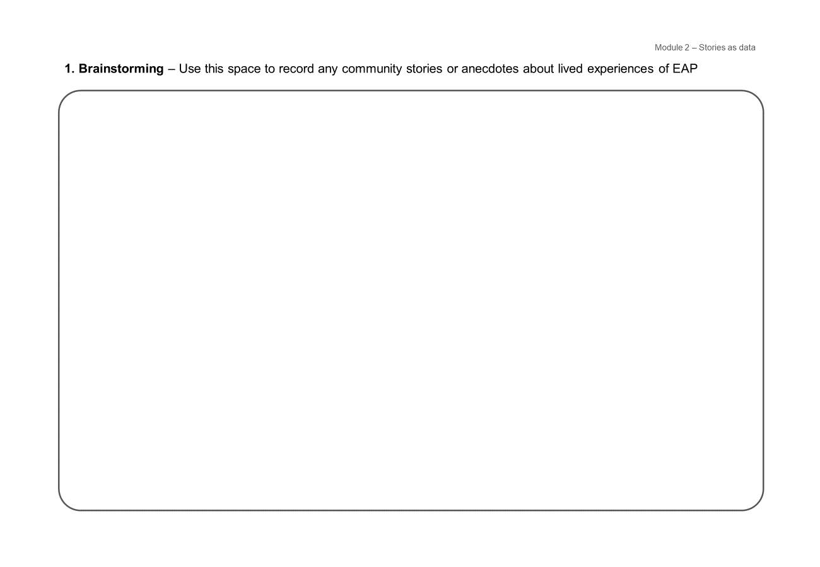
Tool & facilitation guide
Stories brainstorming
Module 2 – Stories as data
1
Add sticky notes for each story about energy poverty (or lack of energy access)
Facilitator notes
Stories could be related (but not limited)
to challenges with:
Energy connection or reliability
Bill affordability and payment systems
Thermal comfort at home, workplaces, schools
Health, economic and/or social consequences of energy poverty or lack of energy access

Slide 46
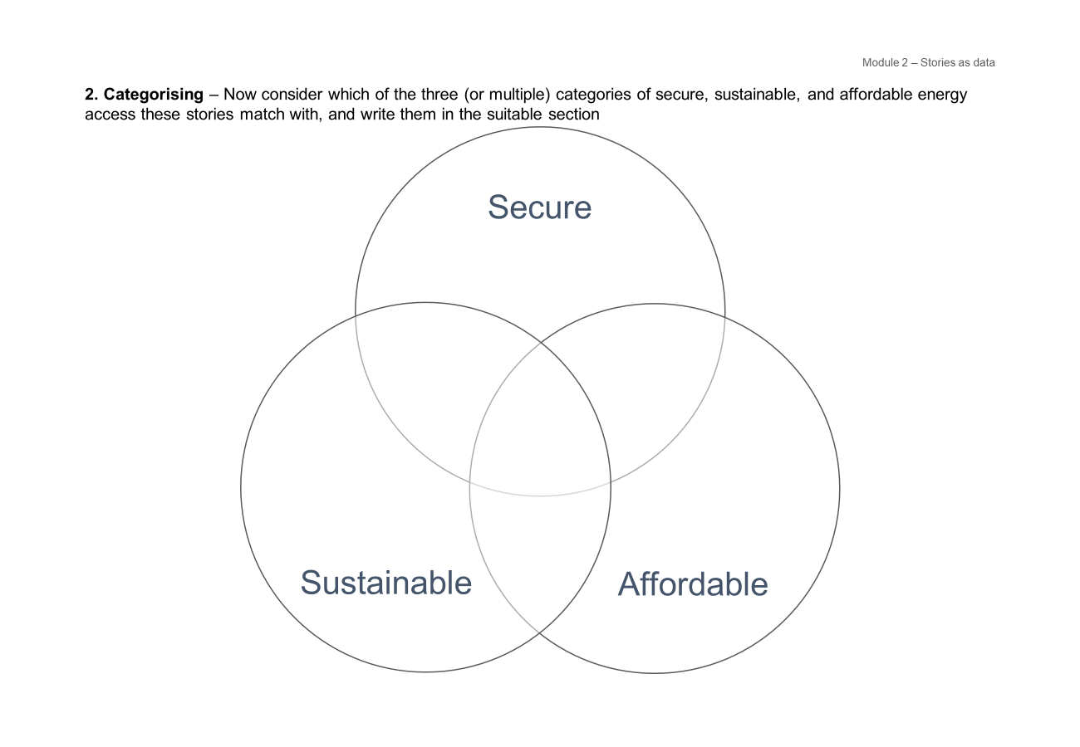
Tool & facilitation guide
Categorising into secure, sustainable and affordable energy
Module 2 – Stories as data
2
Move the sticky notes to this page, placing them according to the relevant category of energy access
Facilitator notes
Some action may overlap
2 or more categories
*
If possible, start to group the sticky notes into themes for the next step

Slide 47
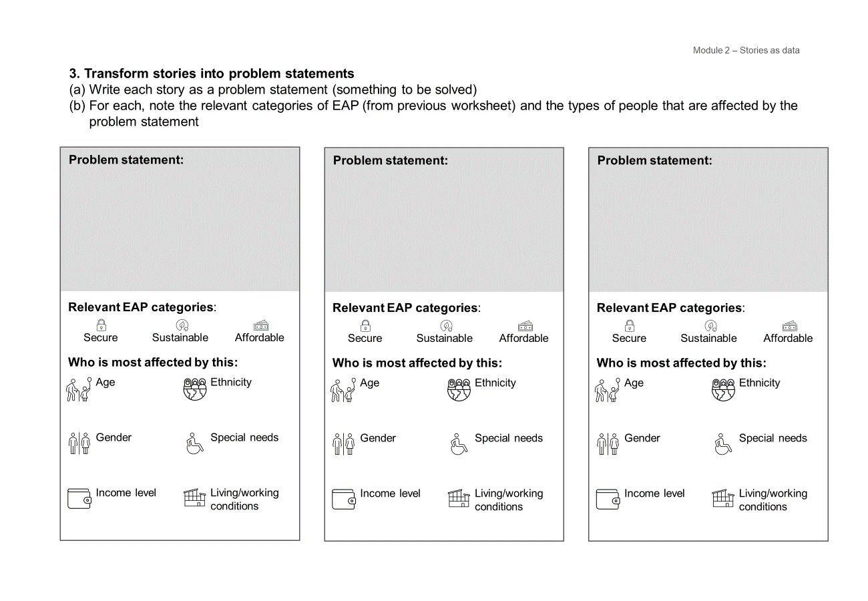
Tool & facilitation guide
Problem statements
Module 2 – Stories as data
Facilitator notes
The problem statement should point out the EAP challenge as
a situation that needs to be discussed and resolved
3
For each theme group, summarise the challenge(s) as a problem statement
4
Use the icons to note the EAP category and type of people or communities impacted by the problem statement
Facilitator notes
These problem statement cards can be printed and completed in a workshop, or for documentation and communication with stakeholders.

Slide 48
Module 2 – Lived experience as data
1. Brainstorming – Use this space to record any community stories or anecdotes about lived experiences of EAP
Notes:
Tool (worksheet) should:
Note what lived experiences their communities and/or city departments are most conscious of, and what these tell them as “qualitative proxies” of mandatory and non-mandatory EAPP indicators
All of the above should be organised (as far as possible/sensible) according to the 3 categories of secure, sustainable and affordable
Next idea – find a way to organise by 3 categories, while getting them to brainstorm from a starting point of stories, narratives and/or anecdotes city staff hear from local communities; then provide a way to translate that into a qualitative data point (this might be useful)

Slide 49
Module 2 – Lived experience as data
2. Categorising – Now consider which of the three (or multiple) categories of secure, sustainable, and affordable energy access these stories match with, and write them in the suitable section
Secure
Affordable
Sustainable
Notes:
Tool (worksheet) should:
Note what lived experiences their communities and/or city departments are most conscious of, and what these tell them as “qualitative proxies” of mandatory and non-mandatory EAPP indicators
All of the above should be organised (as far as possible/sensible) according to the 3 categories of secure, sustainable and affordable
Next idea – find a way to organise by 3 categories, while getting them to brainstorm from a starting point of stories, narratives and/or anecdotes city staff hear from local communities; then provide a way to translate that into a qualitative data point (this might be useful)

Slide 50









Module 2 – Stories as data
3. Transform stories into problem statements
Write each story as a problem statement (something to be solved)
For each, note the relevant categories of EAP (from previous worksheet) and the types of people that are affected by the problem statement
Problem statement:
Problem statement:
Problem statement:
Relevant EAP categories:
Relevant EAP categories:
Relevant EAP categories:
Secure | Sustainable | Affordable
Secure | Sustainable | Affordable
Secure | Sustainable | Affordable
Who is most affected by this:
Who is most affected by this:
Who is most affected by this:
Age | Ethnicity
Gender | Special needs
Income level | Living/working conditions
Age | Ethnicity
Gender | Special needs
Income level | Living/working conditions
Age | Ethnicity
Gender | Special needs
Income level | Living/working conditions

Slide 51
Health-check worksheet
Stories as data
Module 2 – Lived experience as data
What are the most prominent EAP stories in your local communities? | What are the key problems to be solved? | What does the story tell you about potential solutions?
Notes:
Laurie

Slide 52
Module 3
Mapping available local data

Slide 53
Mapping available local data
Module 3 – Mapping available local data
The indicators in the EAPP address the three key energy access attributes and assess the degree to which energy is secure, sustainable, and affordable.
EAP is a complex and multi-faceted challenge that is contextual and unique to each local government. A combination of factors including local energy prices, local housing stock, household income, household energy needs, and local climate together contribute to specific experiences and contexts of EAP.
Energy poverty is a direct expression of deprivation in a city’s every-day life. It is both background context and an impact experienced by individuals, households, and communities.
The tool in this module will help guide you to understanding how to map which data you have and how this aligns with the EAPP’s indicators.
Module objectives
Map what data is useful and crucial to understand, communicate and monitor EAP in your local government area
Understand what quantitative data is and is not available to local governments, and action to collect data
Other useful resources
World Bank Open Data
International Energy Agency (IEA) annual data
United Nations Sustainable Development Goal 7 (SDG 7) tracker
World Bank Regulatory Indicators for Sustainable Energy (RISE)
Region-specific public datasets are also suggested in this module’s Excel-based tool
Notes:
Laurie
Overview and explanation of CRF and EAPP indicators
Discussion on how and why the definition of EAP is very contextual and unique (refer to 2023 literature review and survey)

Slide 54
Why are indicators important?
Module 3 – Mapping available local data
Tracking progress against the indicators in the EAPP is part of the reporting requirements for all GCoM signatories, designed to help local governments understand your EAP contexts and act towards a more sustainable future.
The indicators in the EAPP are split between mandatory and non-mandatory, and global and regional. Local governments are expected to report against at least one mandatory indicator for each energy access attribute relevant for your region. You are also encouraged to report global and regional non-mandatory indicators.
Local governments are well-placed to improve energy access and alleviate energy poverty due to your ownership of the collection, analysis, and communication of data, and proximity to local contexts, stories and lived experiences. Many local governments have ownership of the collection, analysis, and reporting of local socioeconomic data. This is an area of both accountability and opportunity.
We can ask ourselves:
How can data be aggregated
and communicated in sensitive
and constructive ways?
How can data collection involve the
local community more directly in sharing
their lived experiences?
How can data be used to coordinate local stakeholders on solutions for energy access and energy poverty, and advocate for policy and programmes with regional and national governments?
Notes:
Talks about data, textbook format, more information and detail
Difference between mandatory and non mandatory, importance of indicators as a concept
First part of the research report
The cities aggregate the data, are well positioned

Slide 55
Utilities as data sources
Module 3 – Lived experience as data
Utility companies as EAP stakeholders
Local utilities can provide a lot of the useful data that is covered in the global mandatory, non-mandatory and regional non-mandatory indicators. Utility companies, might have relevant data, but may not be keen on sharing it with the municipality they operate in. It is thus important to advocate for utility companies to share this data with local governments. Local governments should also look at utility companies for collaboration to access the data that they own.
Whilst small utilities may not be able to paint a full picture from their data, they are able to contribute to the understanding of EAP within the local boundary.
Examples of EAP indicators that utility companies can help respond to:
Source mix of thermal energy (heating and cooling) consumed in your city
Average number of electric supply interruptions in a typical month (or year)
Total installed energy capacity within local boundary
Electricity bill collection rate
Population able to/willing to pay for electricity
Etc…

Slide 56
EAP indicators database tool
Module 3 – Mapping available local data
This tool will enable you to identify and document
which EAP indicators are most relevant to your local government. A library of links to public datasets is also provided to support data collection and reporting
to GCoM’s Common Reporting Framework via the CDP-ICLEI Track.
In order to prioritise the data, you can use the information collected from module 1 to identify what data you need based on the stories uncovered.
The datapoints can be related to the stories
from Module 2, serving as “qualitative data”
for measuring the mandatory, non-mandatory and regional indicators of the EAPP.
Download this Excel-based tool here
When to use this Tool
You can use this tool when you need to report against mandatory, non-mandatory and regional indicators as
a part of the GCoM’s CRF.
Who should be part of the conversation
Local government departments related to energy infrastructure and regulation, social support, city planning
Local utility companies
Suggested set-up and logistics
This tool is presented in an Excel workbook
with four separate sheets. The worksheet for the second part of this tool can be printed large and used
to guide and inform discussions to make the case for energy access.

Slide 57
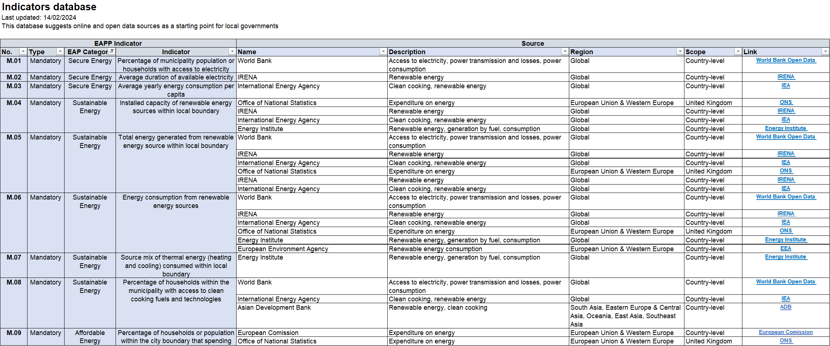
Tool & facilitation guide
Indicator database
Module 3 – Mapping available local data
1
The GCoM EAP Pillar indicators are organised (and can be filtered) by:
Mandatory and non-mandatory indicators
EAP category (secure, sustainable, affordable
2
The suggested public datasets are detailed
and linked – most of these are for national-
or regional-level data

Slide 58
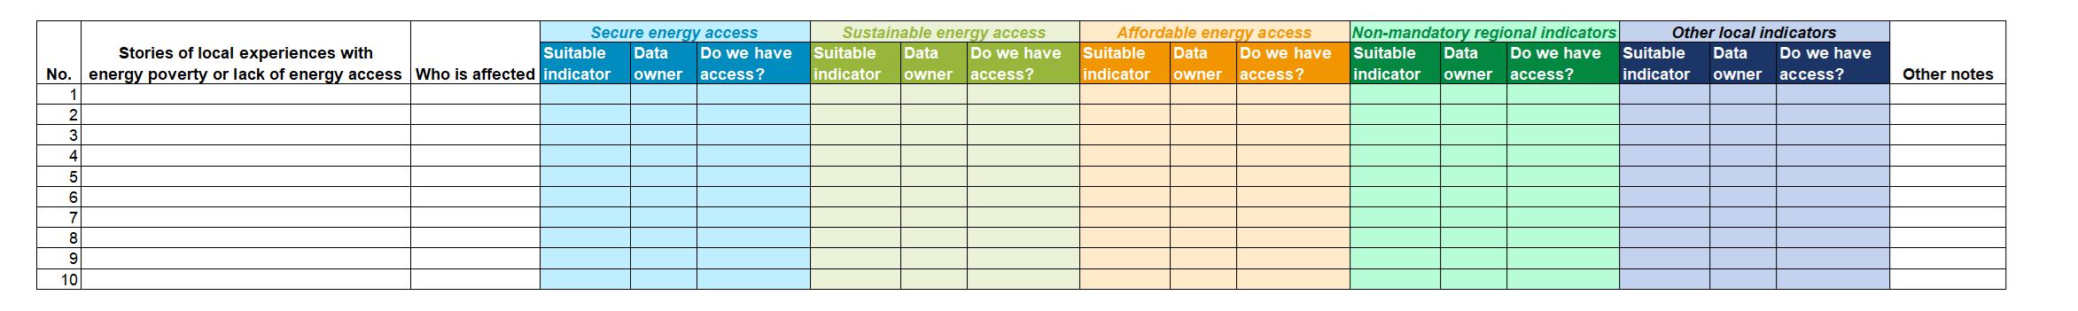
Tool & facilitation guide
Indicator mapping worksheet
Module 3 – Mapping available local data
An additional template is included, as a workshop or planning tool to map relevant datapoints to problem statements
found in Module 2.
For each EAP category, note:
What indicator is useful?
(The indicator database sheet and/or findings from Module 2 may be helpful)
Where is this data collected and/or managed by your local government or external stakeholders?
Do you and/or your team currently have access to this? What are the steps to obtain this data?

Slide 59
Health-check worksheet
Mapping available local data
Module 3 – Mapping available local data
What quantitative data do you collect or have access to? | Where is this data held in your administration?
What quantitative data do you not collect or have access to? | Which sources of data can you use from the tool?

Slide 60
Module 4
Developing an
EAP baseline

Slide 61
Developing an
EAP baseline
Module 4 – Developing an EAP baseline
Modules 2 and 3 bring together different perspectives on EAP and enable cities and local governments to develop your understanding of contextual issues.
Developing and understanding your local government’s specific EAP baseline is important, as this baseline will layout the local context of energy access and poverty. It provides a way to compare the “before” and “after”. This first step will enable the planning of appropriate interventions for local governments.
Module objectives
Draft a definition of EAP in your local government area that is easy to
communicate and understand across a
diversity of stakeholders
Notes:
Module introduction content
Discussion of how understanding the specific context of EAP in a city enables the planning of levers and solutions going forwards

Slide 62
Baselining tool
Module 4 – Developing an EAP baseline
This tool will help you to formulate the EAP baseline for your context, based on the stories and quantitative data about EAP in your local government area. This EAP baseline will likely be unique, taking into consideration the multiple factors which provide a holistic overview of EAP in your households and communities.
As a first step to this tool, you will record key quantitative data points and key lived experiences on sticky notes. These sticky notes can then be sequenced to complete the worksheet, guiding you to a baseline as a short paragraph.
You can complete as many versions of this worksheet as you need to be able to capture the baseline for your context.
When to use this Tool
To build a definition of EAP that is specific to your local government’s context. Findings from modules 1 and 2 (or equivalent) are key inputs.
Who should be part of the conversation
Local government departments related to energy infrastructure and regulation, social support, city planning
Community organisations
Suggested set-up and logistics
Worksheets printed as posters or placed on virtual whiteboard. Sticky notes will be helpful, where each note should have 1 story or quantitative data point.
Notes:
Laurie

Slide 63
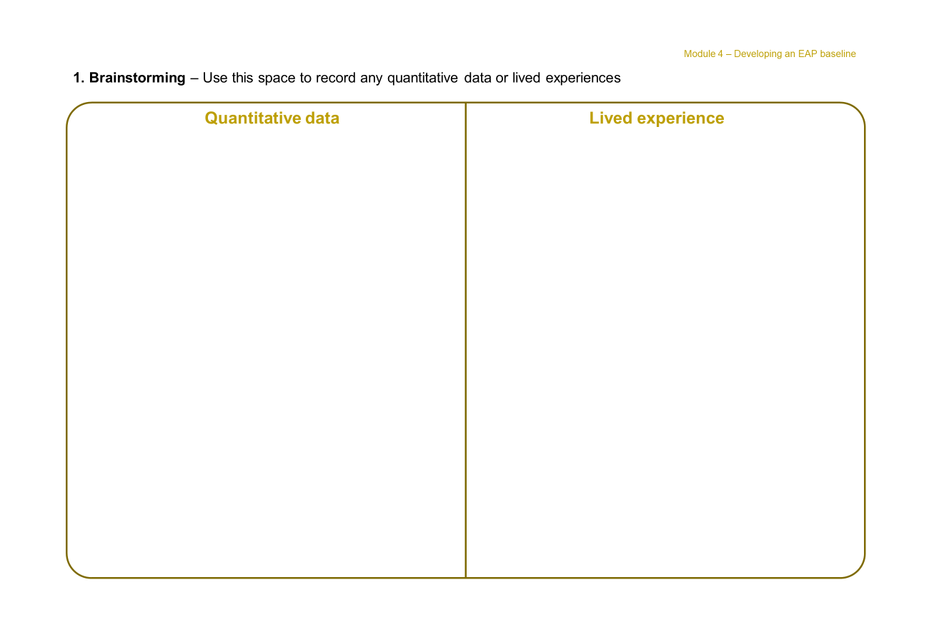
Tool & facilitation guide
Collating stories & quantitative data
Module 4 – Developing an EAP baseline
Facilitator notes
Where possible, start grouping themes across data and stories during this discussion
1a
Note the data headlines that describe energy access challenges or energy poverty in your local government area
(from Module 3 findings, if available)
1b
Note the stories and/or problem statements describing energy access challenges or energy poverty in your local government area (from Module 2 findings,
if available)
Example
Sustainable energy transition is not usually an immediate and single-step transition; households in Mozambique and Togo without electricity access rely on multiple energy sources, including biomass, for different applications and to provide redundancy in supply.
Example
Indicator for transition source mix of energy for heating and cooling

Slide 64
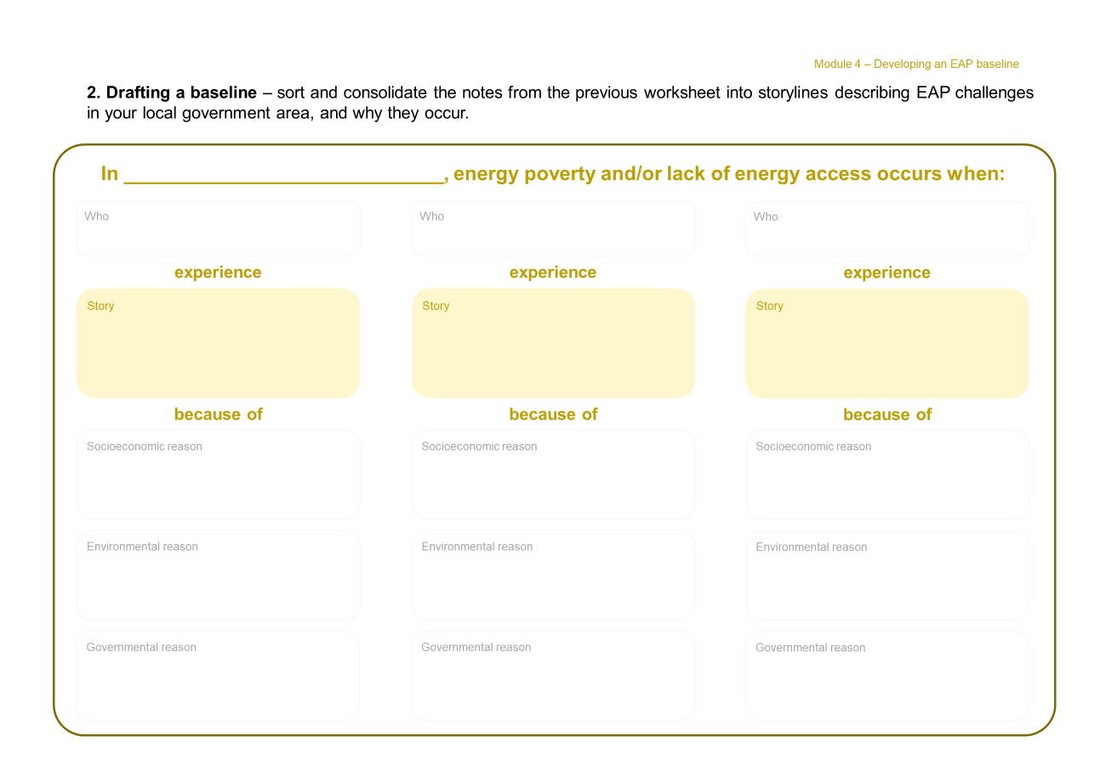
Tool & facilitation guide
Collating stories & quantitative data
Module 4 – Developing an EAP baseline
Facilitator notes
Multiple copies of this worksheet can be used to collate more experiences. However, we suggest keeping the definition short if possible and appropriate – for simpler communication and understanding by a wider audience.
2
Summarise the grouped themes as a title in the yellow box
3
Detail the social, economic, environmental, meteorological, governmental and/or political reasons for this form of energy poverty or lack of energy access

Slide 65
Module 4 – Developing an EAP baseline
1. Brainstorming – Use this space to record any quantitative data or lived experiences
Quantitative data
Lived experience

Slide 66
Module 4 – Developing an EAP baseline
2. Drafting a baseline – sort and consolidate the notes from the previous worksheet into storylines describing EAP challenges in your local government area, and why they occur.
In _____________________________, energy poverty and/or lack of energy access occurs when:
Who
Who
Who
experience
experience
experience
Story
Story
Story
because of
because of
because of
Socioeconomic reason
Socioeconomic reason
Socioeconomic reason
Environmental reason
Environmental reason
Environmental reason
Governmental reason
Governmental reason
Governmental reason

Slide 67
Health-check worksheet
Developing an EAP baseline
Module 4 – Developing an EAP baseline
What is your challenge area summary?

Slide 68
Module 5
Understanding local barriers

Slide 69
Understanding local barriers
Module 5 – Understanding local barriers
Module objectives
Self-identify what are the key barriers experienced as local government staff in addressing energy poverty or improving energy access
Discuss which of these barriers are obvious and tangible, due to gatekeeping by other actors, and/or narrative blocks around what is possible for residents and communities
Discuss which barriers are interrelated within EAP, or other local issues and forms of deprivation
Exploring local governments’ barriers and powers uncover the complexity they work within, as a starting point to map potential ways forward. Exposing such barriers can help to identify opportunities to innovate solutions; within their administrations or by collaborating with relevant community, private sector, regional and national stakeholders.
Notes:
Module introduction content
Discussion of how understanding the specific context of EAP in a city enables the planning of levers and solutions going forwards

Slide 70
Why think about barriers?
Module 5 – Understanding local barriers
Make sense of every-day experiences of local government staff in progressing EAP solutions
Despite being very aware of and committed to facilitating energy access and addressing energy poverty, many local governments face specific barriers in their planning and implementation.
Understanding the local challenges experienced by local government staff in approaching EAP is crucial to understand where efforts need to be directed. Mapping and analysing barriers to EAP enable understanding as to how and why local governments’ planning – and the efficacy of their efforts – might be limited.
Focus solutions and resources
Exposing EAP barriers can help to identify opportunities to innovate solutions. This could be within local government administrations or by collaborating with relevant community, private sector, regional and national stakeholders.

Slide 71

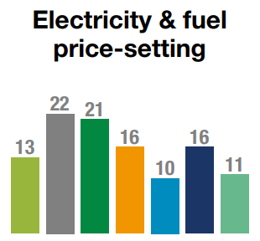
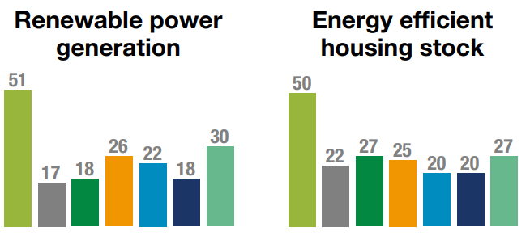
Energy access barriers in cities
Module 5 – Understanding local barriers
Barriers found in 2023 research
There are seven categories of barriers identified by local governments on EAP:
Barrier types can change according to different areas of EAP. Some examples of EAP action areas can include renewable power generation, energy efficient housing stock, low carbon heating/cooling or electricity & fuel
price-setting just to name a few. Whilst finance could be
a main driver for many of these action areas, other barriers such as data are more prevalent in EA aspects like electricity & fuel price-setting.
    Financing solutions
    Institutional capacity and structure
    to deliver
    Lack of knowledge and understanding of physical and human context
    Navigating policy landscapes
    Engagement and collaboration
    with stakeholders
    Availability of data
    Lack of political leadership
    The graph above is from the 2023 Research Report, Unlocking Urban Energy Access and Poverty where 74 GCoM signatories completed an online survey and data analysis on their barriers, local government powers and initiatives in improving energy access and alleviating energy poverty. This graph outlines the barriers named by respondents as most significant to different energy access action areas.

Slide 72
Barrier types
Module 5 – Understanding local barriers
Finance
Barriers relating to accessing funding and financing from public, private and IFI sources for the development and deployment of schemes to improve energy access.
Institutional capacity and structure
Challenges relating to limited capacity to provide policy and business services support to develop and manage schemes to improve energy access, as well as barriers created by the distribution/devolution of relevant powers amongst different levels of government.
Physical and human context
Challenges that relate to a city or community’s geographical location and demographic characteristics that can affect the viability of schemes to improve energy access, including historical land use planning.
Policy landscape
Policies and regulations create barriers to market entry or do not create a supportive policy environment for improved energy access, for example limiting the ability of small-scale energy projects to establish economically viable schemes.
Engagement and collaboration
Lack of effective engagement and collaboration with communities, private sector and other important stakeholders such as higher-tier government.
Data
Challenges that relate to a local government’s ability to access information and acquire knowledge required to take effective decisions.
Political and leadership
Challenges related to prevailing political ideologies or priorities, governance typologies, or the strength of leadership from key actors.
Notes:
Graphic of barrier types and definitions of each (from previous report)

Slide 73
Identifying your barriers
Module 5 – Understanding local barriers
This tool will guide you to identify the barriers to EAP in your local context, recognise the relationships and interconnectedness between these barriers, and note other issues in your context that are related.
Understanding your barriers is important to select appropriate interventions and implement them effectively. In contrast to the stories of local experiences in Module 1, these are about the challenges in your every-day work as local government officers in policy and solution implementation to address EAP.
If you have completed previous modules it is useful to reflect back on the first module to revisit the stories you have found and understand why these stories are present, and what the barriers are that create these stories.
When to use this Tool
You can use this tool when you understand what EAP looks like in your context and are ready to identify which barriers you face. This should focus more on barriers in your EAP work, instead of barriers to access in the communities you work with.
Who should be part of the conversation
Local government staff who have an overview of EAP in your city's context.
Suggested set-up and logistics
The following pages can be printed as large posters. Use post-its or pens to complete the work sheets.
Notes:
Laurie – types of barriers in political economy
similar exercise to lived experience
Clear barriers, gate keeper barriers, narrative barriers (culture and community)
Develop categories and framings within the categories

Slide 74
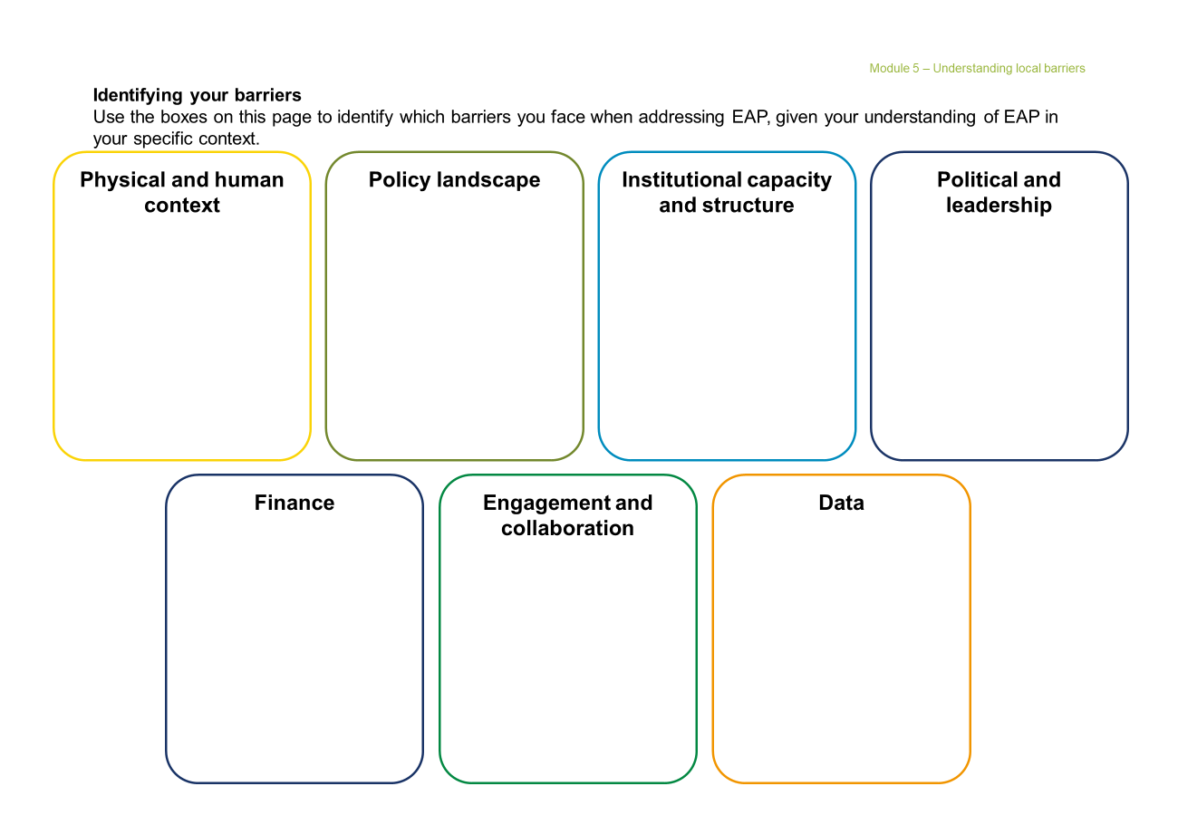
Tool & facilitation guide
Identifying local government barriers
Module 5 – Understanding local barriers
Add sticky notes for each local government barrier that you and/or your team experience in EAP work
Facilitator notes
To help discussion, print extra copies of this worksheet to either:
Allow colleagues to brainstorm
on individual worksheets before
a group discussion
A larger worksheet to discuss and summarise your local government’s barriers in each category
Facilitator notes
When brainstorming barriers, it could be helpful to reflect about:
What administrative barriers do we face?
Are there any political barriers?
What are the everyday things that make us feel like a solution or policy is not possible?

Slide 75
Module 5 – Understanding local barriers
1. Identifying your barriers
Use the boxes on this page to identify which barriers you face when addressing EAP, given your understanding of EAP in your specific context.
Physical and human context
Policy landscape
Institutional capacity and structure
Political and leadership
Finance
Engagement and collaboration
Data

Slide 76
Module 5 – Understanding local barriers
Health-check worksheet
Understanding city barriers
What are the key barriers
you experience in addressing
energy poverty or improving
energy access?
Which is the most challenging barrier type for your local government?
Which barriers are related to other issues (or forms of deprivation)
in your context?
Notes:
Self-identify what are the key barriers they experience as city staff in addressing energy poverty or improving energy access
Discuss which of these barriers are obvious/tangible, due to gatekeeping by other actors, and/or narrative blocks around what is possible/impossible for them/communities
Discuss which barriers are interrelated within EAP or other issues (or forms of deprivation) in their city

Slide 77
Module 6
Maximising available local powers

Slide 78
Maximising available local powers
Module 6 – Maximising available local powers
Module objectives
Self-identify the EAP assets in which local governments have full, shared or no powers to influence policy and implement solutions
Reflect and brainstorm how and where local governments have convening and advocacy powers
Other useful resources
Resource pack on city powers to advance a just energy transition in Europe through relief, retrofits and renewables by C40 Cities
Targeting actions within available powers and resources
Local governments often have limited direct powers to control the urban assets and functions that generate and supply energy. Understanding where different levels of government, utilities, and wider stakeholders
do have powers can support local governments to take effective and efficient action through targeted collaboration.

Slide 79
Local government powers in EAP sectors
Module 6 – Maximising available local powers
Set vision & policy
The ability to establish the overall vision, goals, strategies, and policies relating to the asset
Knowing where decision-making authority is owned, shared, or unavailable
The extent of local government powers over the urban assets and functions important to support energy access and alleviate energy poverty vary strongly by national context and asset type. Characterising these differences will help you to understand where there are opportunities to act.
Powers over EAP assets can be categorised into five main dimensions, which each address a different way in which local government can exert power and influence.
Correlation of powers with barriers
Based on available capacity and powers, local governments can use different approaches to address their barriers (Module 5) to energy access by maximising their available powers via collaboration.
Own/ operate
The ownership or responsibility to operate the asset & policy
Set regulation
The responsibility for establishing regulation to govern assets and pricing
Power dimensions
Enforce regulation
The responsibility for enforcing regulation that governs assets and pricing
Control budget
The ability to control or establish the budget for the asset

Slide 80
Identifying your powers
Module 6 – Maximising available local powers
Understanding the dimensions of power that you have in your national and local context is important to identify appropriate approaches to addressing EAP: the power to set vision and policy, the power to own/operate assets, the power to set regulation, the power to enforce regulation, and the power to control budget spend.
This tool will enable you to map your powers – unpacking the complexity across:
Convening powers (stakeholder engagement and collaboration)
Advocacy powers (with national government and other regional/global bodies)
Direct powers (local government control)
When to use this Tool
This tool is especially useful with a baseline understanding of what EAP looks like in your context (from modules 1 to 5).
Who should be part of the conversation
Local government staff who have an overview of the findings from modules 1 to 5, and any other city staff who work with EAP.
Suggested set-up and logistics
Print the powers grid as a large poster to identify your city's powers in each dimension.
You can use three different colours of sticky notes to mark the degree of powers for each area of convening, advocacy or direct powers.

Slide 81
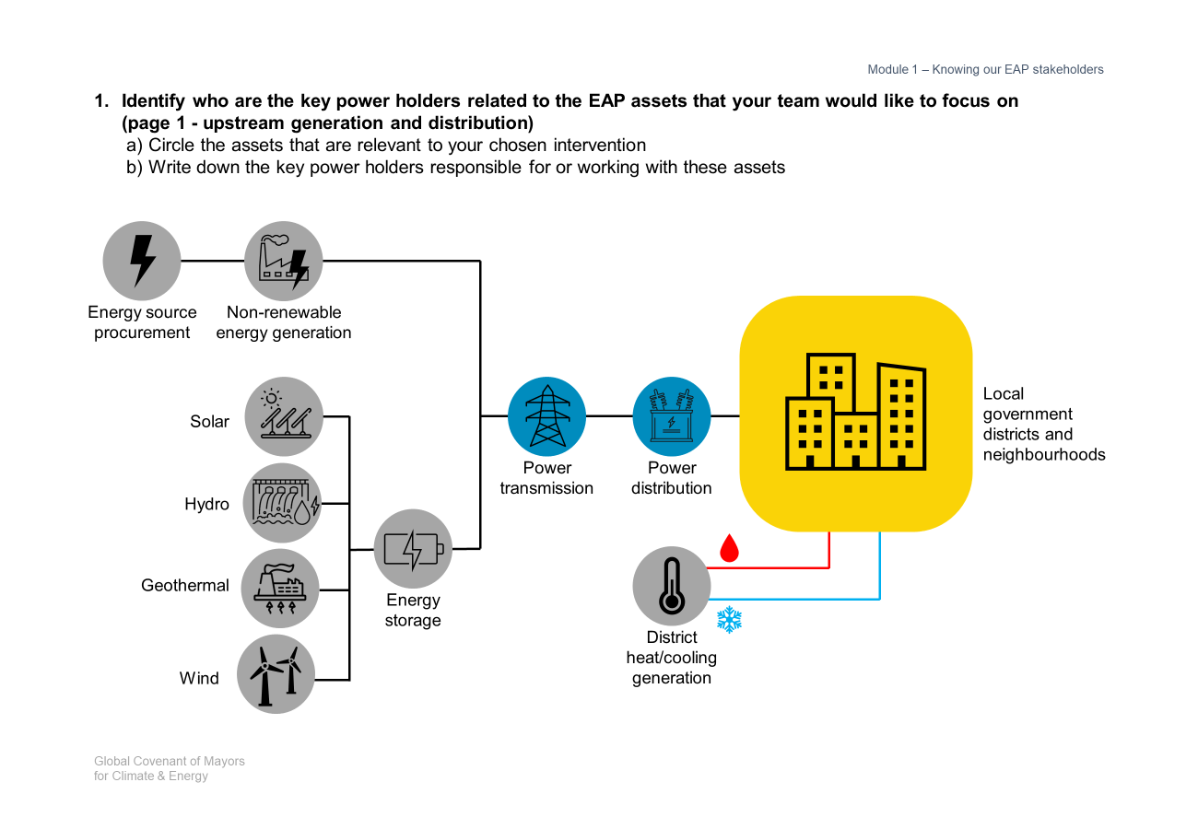
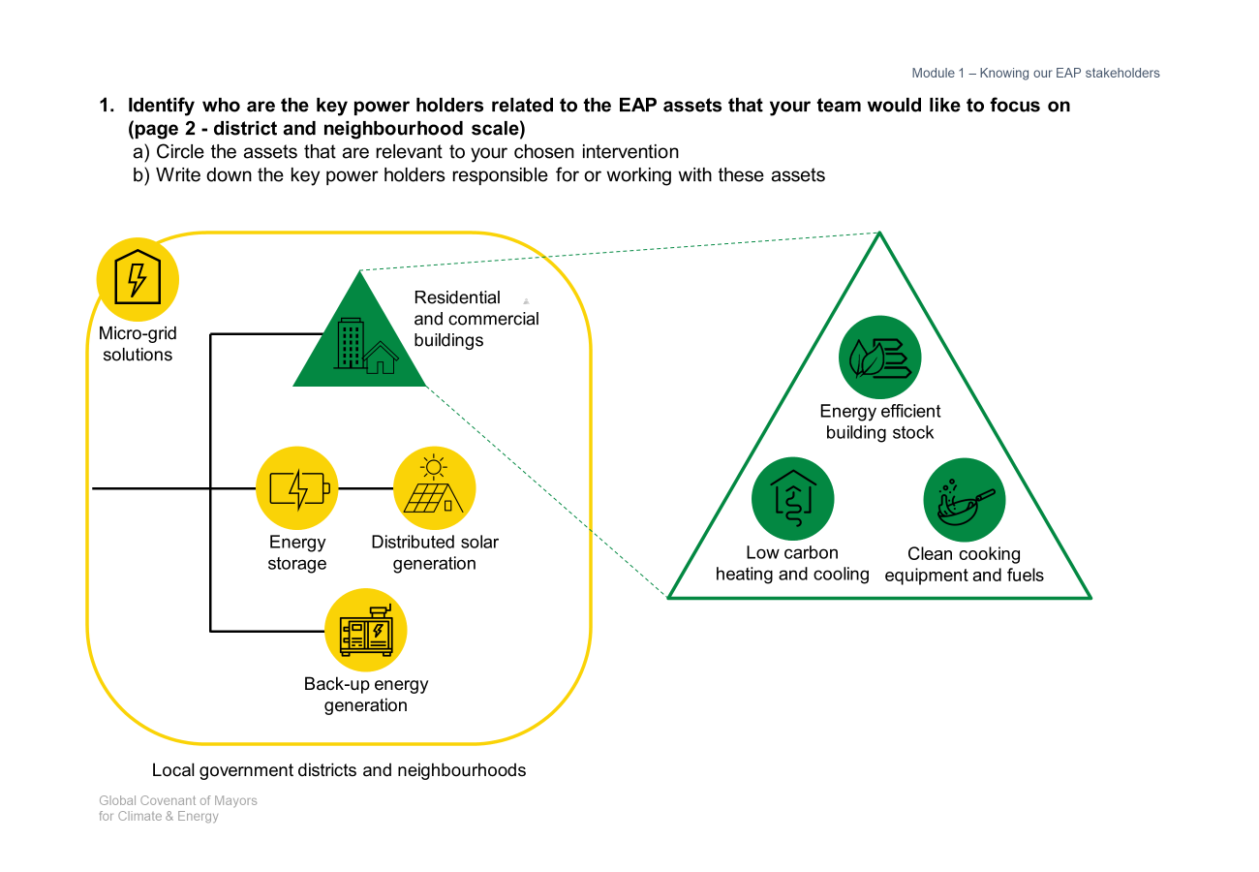
Tool & facilitation guide
EAP asset and scope identification
Module 6 – Maximising available local powers
Facilitator notes
This step is optional, especially if you have done this exercise in module 1 and have the same focus.
1
Circle the EAP assets that the team would like to focus on
Facilitator notes
Use different colour sticky notes or pens to note if the powers are to convene, advocate, or directly control.
2
Using sticky notes,
Write down the key power holders for these assets

Slide 82
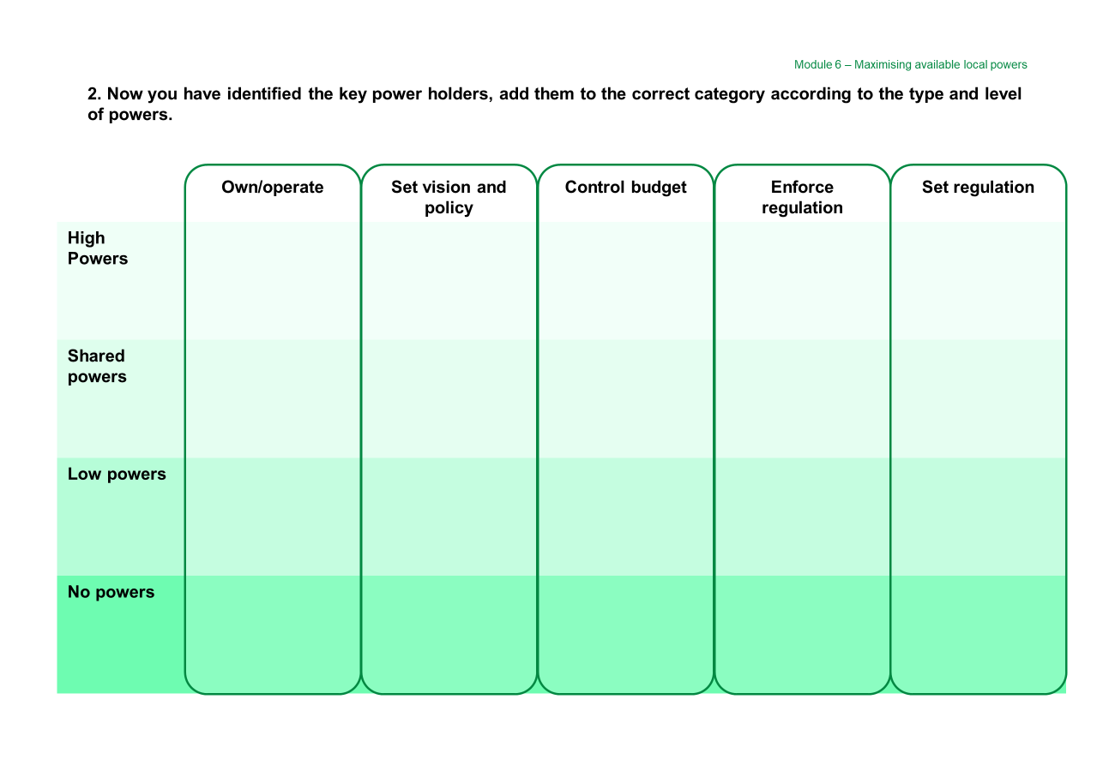
Tool & facilitation guide
Powers analysis
Module 6 – Maximising available local powers
Place sticky notes for each organisation to note their level and type of powers for the aspect of control over EAP assets
You might have to add more than one sticky note for one organisation if they control more than one aspect of an EAP asset

Slide 83
Module 6 – Maximising available local powers
Identify who are the key power holders related to the EAP assets that your team would like to focus on
(page 1 - upstream generation and distribution)
  Circle the assets that are relevant to your chosen intervention
  Write down the key power holders responsible for or working with these assets
Energy source procurement
Non-renewable
energy generation
Local government districts and neighbourhoods
Solar
Power transmission
Power
distribution
Hydro
Geothermal
Energy
storage
District heat/cooling generation
Wind

Slide 84
Module 6 – Maximising available local powers
Identify who are the key power holders related to the EAP assets that your team would like to focus on
(page 2 - district and neighbourhood scale)
  Circle the assets that are relevant to your chosen intervention
  Write down the key power holders responsible for or working with these assets
Residential
and commercial
buildings
Micro-grid solutions
Energy efficient
building stock
Energy
storage
Distributed solar
generation
Low carbon
heating and cooling
Clean cooking equipment and fuels
Back-up energy generation
Local government districts and neighbourhoods

Slide 85
Module 6 – Maximising available local powers
2. Now you have identified the key power holders, add them to the correct category according to the type and level of powers.
Own/operate
Set vision and policy
Control budget
Enforce regulation
Set regulation
High Powers
Shared powers
Low powers
No powers

Slide 86
Health-check worksheet
Maximising available city powers
Module 6 – Maximising available local powers
Which EAP assets do you have full, shared, or no powers to influence policy and implement interventions?
Full Powers to influence
Shared Powers to influence
Who do you share these powers with?
Low Powers to influence
Which stakeholders do have powers?

Slide 87
Module 7
Designing EAP interventions

Slide 88
Designing EAP interventions
Module 7 – Designing EAP interventions
Module objectives
Reflect on your local government’s appetite for specific interventions based on time horizon, current capacity, and powers available
Self-identify which interventions are prioritised and suitable for your local government and residents
Detail interventions and break them down into smaller steps
Other useful resources
International Energy Agency’s energy efficiency policy toolkit
REN21’s Mini-grid Policy Toolkit
There are five different interventions which local governments can employ to improve energy access and reduce energy poverty:
Policies & regulation
Stakeholder collaboration
Internal capacity building & data collection,
Investment & securing finance
City-led programmes.
It is important to note that these interventions are influenced by the barriers and power structures they operate in. This relationship will be explored in the tool for this module.
These interventions are based on the 2023 Research Report on Unlocking Energy Access, from desk research and an online survey completed by 74 GCoM signatories that enquired about initiatives in improving energy access and alleviating energy poverty. These interventions are referred to as levers, but the word intervention is a better representative between the evidence base and the actual action you will get to.
Notes:
Identify a range of levers

Slide 89
EAP interventions
Module 7 – Designing EAP interventions
The approaches can be concretely demonstrated in the types of interventions that local governments use to address energy poverty and advance energy access.
Local governments can refer to these different interventions as a starting point to understand where they are in their energy access journeys.
These interventions can also be used
as inspiration for potential actions. They should be adapted to reflect your local government’s unique context.
Policies & regulation
Interventions in this category are focused on establishing policies and regulation to enable local government interventions, private sector innovation, and community stakeholder development
Stakeholder collaboration
Local government actions to engage with communities, the private sector, as well as other tiers and branches of government towards data collection and implementing energy access solutions
Internal capacity building & data collection
Interventions to increase the technical and resource capacities of local governments, as well as establishing clear monitoring, evaluation and reporting
Investment & securing finance
Interventions to secure local, national, and international funding for solutions in implementing energy access policies and programmes
City-led programmes
When energy access solutions do not have cost
or administrative effectiveness for large-scale programmes and diverse infrastructure and assets, local governments can directly undertake programmes and projects.

Slide 90
Approaches to designing EAP interventions
Module 7 – Designing EAP interventions
Shifting our perspective on taking action
When identifying and developing interventions based on unique contexts and limited resources, we suggest that local governments reflect on the three approaches listed on the right to address their barriers to energy access.
This is a change in how we talk about, prioritise, and evaluate actions. This is especially important when the results of energy access planning and implementation may not be immediate or obvious. The benefits may also not be appreciated by those less concerned about energy poverty.
These approaches can be iteratively and increasingly introduced to governance, policies and programmes, and reporting. They also overlap and reinforce each other – serving not only communities’ increased energy access, but also other local government priorities in sustainability, social equity, and beyond.
Evaluating both short- and long-term outcomes
Prioritise complex community, private sector, and vertical engagement that may not produce tangible nor immediate results
Efficient, effective and equitable capacity allocation
Provide city staff the clarity and mandate to allocate resources towards equitable planning and outcomes in their everyday work
Maximising available powers by collaboration
Seek spaces, stakeholders and opportunities within their available powers to maximise their innovation, programmes and advocacy
Notes:
Laurie
Unpack the position of the cities, connection to residents and their stories

Slide 91
Identifying key interventions
Module 7 – Designing EAP interventions
Understanding which interventions are appropriate for your local government given your unique governance structure, challenges of EAP, and other contextual factors is an important step to being able to address EAP in your area.
This tool will help you to identify which interventions you can use, and to understand when outcomes are delivered, the level of local government capacity needed, and powers to be maximised to successfully implement the intervention.
This tool will also guide you in how to define your chosen interventions as smaller and actionable steps.
The worksheets in this section set out suggested interventions and have space where you can identify how they could be applied in your context.
When to use this Tool
Use this tool when you are ready to understand which interventions your local government can take to address EAP.
Who should be part of the conversation
Local government staff can use this tool, recognising that the key stakeholders to involve in chosen interventions may extend beyond specific city departments.
Suggested set-up and logistics
The worksheets in this section list suggested interventions. Use the check boxes to indicate which interventions you are interested in. There is space for you to record your notes and to indicate how the intervention could be implemented in your context.
The second worksheet can be used as a demonstrator for interventions that you would like to progress and implement.
Notes:
Laurie

Slide 92
Intervention tags
Module 7 – Designing EAP interventions
The interventions in this section are presented with “tags”, which suggest the time horizon, the resource and capacity demand, and the powers needed to implement the intervention. However, every context is different, and therefore there is also space to record the specific tags relevant to your situation.
Time horizon for which outcomes will be more visible and tangible |  | The level of demand on local government capacity and resources |  | Local government powers that the intervention will apply and maximise
 | Short-term 1-3 years |  | Easy-win Feasible with existing resources |  | Sole powers Local governments have sole authority
 | Medium-term 3-10 years |  | Collaborative action Includes engagement with internal & local stakeholders |  | Shared powers Local governments have sole or shared authority
 | Long-term More than 10 years |  | Extensive collaboration Includes engagement with regional & national actors |  | Limited Powers Local governments have shared or no authority

Slide 93
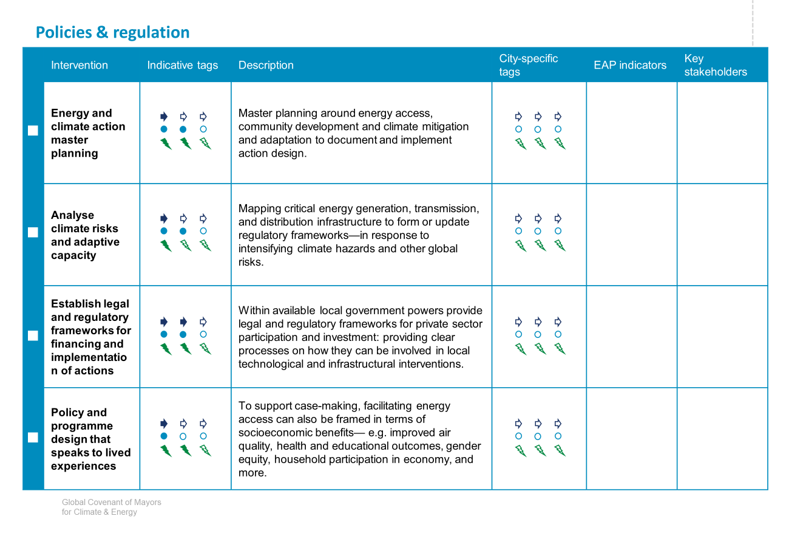
Tool & facilitation guide
Identifying and customising local interventions
Module 7 – Designing EAP interventions
A list of suggested interventions from previous research in 2023 are included as a starting point
Use these columns to note your own local government’s context, EAP needs and indicators addressed, and key action stakeholders
Check these boxes if the interventions are of interest
In planning discussions, use markers and/or sticky notes make comments or edits to interventions –
so that they fit your local government context and needs!
Facilitator notes
Your indicators from Module 2 can be used here, or chosen from the EAPP indicators.

Slide 94
Policies & regulation
 | Intervention | Indicative tags | Description | City-specific tags | EAP indicators | Key stakeholders
 | Energy and climate action master planning |  | Master planning around energy access, community development and climate mitigation and adaptation to document and implement action design.
 | Analyse climate risks and adaptive capacity |  | Mapping critical energy generation, transmission, and distribution infrastructure to form or update regulatory frameworks—in response to intensifying climate hazards and other global risks.
 | Establish legal and regulatory frameworks for financing and implementation of actions |  | Within available local government powers provide legal and regulatory frameworks for private sector participation and investment: providing clear processes on how they can be involved in local technological and infrastructural interventions.
 | Policy and programme design that speaks to lived experiences |  | To support case-making, facilitating energy access can also be framed in terms of socioeconomic benefits— e.g. improved air quality, health and educational outcomes, gender equity, household participation in economy, and more.

Slide 95
Stakeholder collaboration
 | Intervention | Indicative tagging | Description | City-specific tagging | EAP indicators | Key stakeholders
 | Community-led data collection programmes |  | Facilitate the collation and documentation of both quantitative and qualitative data of lived experiences, led by local leaders and residents.
 | Co-design solutions with local communities that speak to specific contexts and needs |  | Embed analytical and stakeholder engagement steps in the policy and programme design processes to ensure they are informed by and apply to specific lived experiences in communities and households.
 | Engage with private sector and academia |  | Tap into private sector and academic know-how to design technical solutions, and implement projects, and provide community training opportunities.
 | Transparent and documented processes |  | To support case-making, facilitating energy access can also be framed in terms of socioeconomic benefits— e.g. improved air quality, health and educational outcomes, gender equity, household participation in economy, and more.
 | Engage with national and regional energy access actors |  | Connect with national and regional bodies and energy supplier to advocate for infrastructural, legislative, or financial solutions
 | Coordinate stakeholders and data for national engagement |  | Connecting and facilitating local and regional stakeholders to make a concerted case for implementing national actions.

Slide 96
Internal capacity building & data collection
 | Intervention | Indicative tagging | Description | City-specific tagging | EAPP indicators | Key stakeholders
 | Central working group for energy access |  | Create and mandate a single coordinating municipal entity to lead ownership, coordination and buy-in of local government departments, relevant regional and national political actors, and relevant private sector and community stakeholders.
 | Joining regional and international platforms |  | Participate in regional and international platforms on energy access to discuss common challenges; enabling opportunities to share best practices, develop common solutions, and form advocacy coalitions.
 | Data-collection networks and infrastructure |  | Build networks between local government departments and relevant external agencies or private sector partners to collate datasets on energy poverty and energy access. This should be supported by a central data repository for energy access towards further analysis and case making for policies, programmes, and vertical integration.
 | Data analysis and case-making |  | Curate evidence-base that provides coherent and systemic methodology to legitimise energy access solutions for policy and financing case-making— pinpointing infrastructural gaps in transmission and distribution, quantitative and qualitative data on household energy consumption, addressing uneven negative consequences of energy poverty, and promoting equitable energy access benefits in the community.
 | Monitoring, evaluation and reporting frameworks to support planning |  | Establish cost- and resource effective strategies within strategic, policy and programme planning to monitor and evaluate energy access circumstances and the efficacy of interventions. Framework should also specify review and update process based on new information/progress.
 | Building local technical knowledge and capacity |  | Provide opportunities for staff to exchange technical knowledge with other local governments, as well as private and academic stakeholders. Involvement in cross-departmental data analysis and master planning provides further opportunities for multi-disciplinary and co-designed interventions.

Slide 97
Investment & securing finance
 | Intervention | Indicative tagging | Description | City-specific tagging | EAP indicators | Key stakeholders
 | Financing energy access programmes |  | Provide grants for, subsidise, or fund interventions—e.g. in residential electrification and energy efficiency retrofits, distributed renewable energy generation, tariff subsidies for low-income households. Co-financing schemes can also be used to encourage ownership and education.
 | Analysis and innovation of funding models |  | Explore innovative finance models to improve cost-parity of solutions and attract large-scale investors, especially in clean energy and district heating/cooling solutions.
 | Energy performance contracting (EPC) |  | Contract an Energy Service Company (ESCO) to deliver energy efficiency retrofits with committed reduction targets; where the intervention costs are paid off via the energy savings made.
 | Engage with potential funders |  | Engage with local, regional, and international funders to support and finance local interventions and interventions, in both hardware and soft data infrastructure.

Slide 98
Programmes led by local governments
 | Intervention | Indicative tagging | Description | City-specific tagging | EAP indicators | Key stakeholders
 | Energy data infrastructure and audit analysis |  | Install smart metering to monitor energy consumption of residential or social housing buildings; process data for energy audits to target energy efficiency interventions.
 | Local community training |  | Conduct training with local community leaders and residents to raise awareness of energy efficiency solutions to ensure expenditure is maximised in improving living conditions and thermal comfort.
 | Energy efficiency retrofits |  | Retrofits to increase energy efficiency of fittings and technology, improve thermal insulation and convert cooking and heating appliances to low carbon alternatives. Local governments can target social housing and other assets under their management.
 | Distributed renewable energy generation |  | Install rooftop or micro solar PV systems to offset or subsidise energy consumption. Local governments can target social housing, administrative buildings, and other assets under their management
 | Financial support for households to improve energy affordability |  | Make energy more affordable by direct reviews of energy and fuel pricing, bill subsidies, or easing the overall financial burden of households via other support such as rent ceilings and employment opportunities.
 | Municipal energy procurement |  | As individual—or a group of— local government(s) sign power purchase agreements with energy providers with secure supply uptimes as well as renewable generation sources.

Slide 99
Module 7 – Designing EAP interventions
Health-check worksheet
Designing EAP interventions
Which interventions are you interested in using?
What are
the smaller, actionable steps you can take to implement these interventions?

Slide 100
Module 8
Making the case for Energy Access

Slide 101
Making the case for Energy Access
Module 8 – Making the case for Energy Access
Using the last seven modules in this Toolkit and your local studies, plans and input, it is now important to consolidate the available information. This information is crucial to support advocacy, planning and action financing that is effective and efficient.
To maximise the case for EAP, it is helpful to also be able to recommend synergies with other climate actions and co-benefits. This allows you to gather more expertise, existing and planned solutions, as well as advocacy voices.
Module objectives
Enable cities to make the case for a suite of interventions based on communities’ lived experience
Other useful resources
Climate Toolkits: For Infrastructure PPPs by the World Bank
Asian Development Bank’s Microsoft Excel-Based Tool Kit for Planning Hybrid Energy Systems
Notes:
Support for effective and efficient advocacy, planning and funding applications, by a template to consolidate available information and recommended synergies with other climate actions and co-benefits
Co benefits to make the case
Assess co-benefits of the action
Focused at the action level
Modules 6, 7 and 8 can build on eachother

Slide 102
Telling your EAP action story
Module 8 – Making the case for Energy Access
Who do we advocate to, and why?
Local citizens
To develop solidarity across community groups and provide transparency on the focus of local government resources towards EAP
Technical experts and financial investors
Providing data-driven EAP baseline
and community-specific goals signal to
non-governmental actors where their research and capital should be focused
Regional and national government
To lead the way with similar and neighbouring local governments to justify systemic or infrastructural changes needed to progress energy access or address energy poverty
What makes a strong story
A clear target group for intervention with justification via data and/or community experiences of EAP
Meaningful stakeholder engagement to co-design and/or sense-check EAP solutions, and documentation of this
A vision of the intended outcomes, benefits, and distribution of these benefits for specific demographic groups
Highlights of possible synergies and
co-benefits across other aspects of
climate action and poverty alleviation

Slide 103
Action storytelling tool
Module 8 – Making the case for Energy Access
Understanding the co-benefits and being able to identify synergies between EAP interventions is a key part of making the case for EAP.
There are two parts to this tool:
A co-benefits matrix, where you can review suggested co-benefits of the interventions outlined in Module 7
A “storytelling” worksheet to combine the understanding and knowledge from your local government (and previous modules) to make your case for energy access interventions
Download this Excel-based tool here
When to use this Tool
The first part of this tool builds upon your understanding of which interventions you are interested in using (Modules 7, and any other action-specific analyses), and the second part consolidates your understanding from all the previous modules.
Who should be part of the conversation
City staff who have an overview of the findings from previous modules.
Suggested set-up and logistics
The first part of this tool is a matrix presented in an Excel workbook. The worksheet for the second part of this tool can be printed large and used to guide and inform discussions to make the case for energy access.
Notes:
Laurie
Bring together the previous modules
Have a database of benefits that relate to EAP levers – identify the different cobenefits of different actions
The tool can help reduce the level of effort by bringing all the information into one place

Slide 104
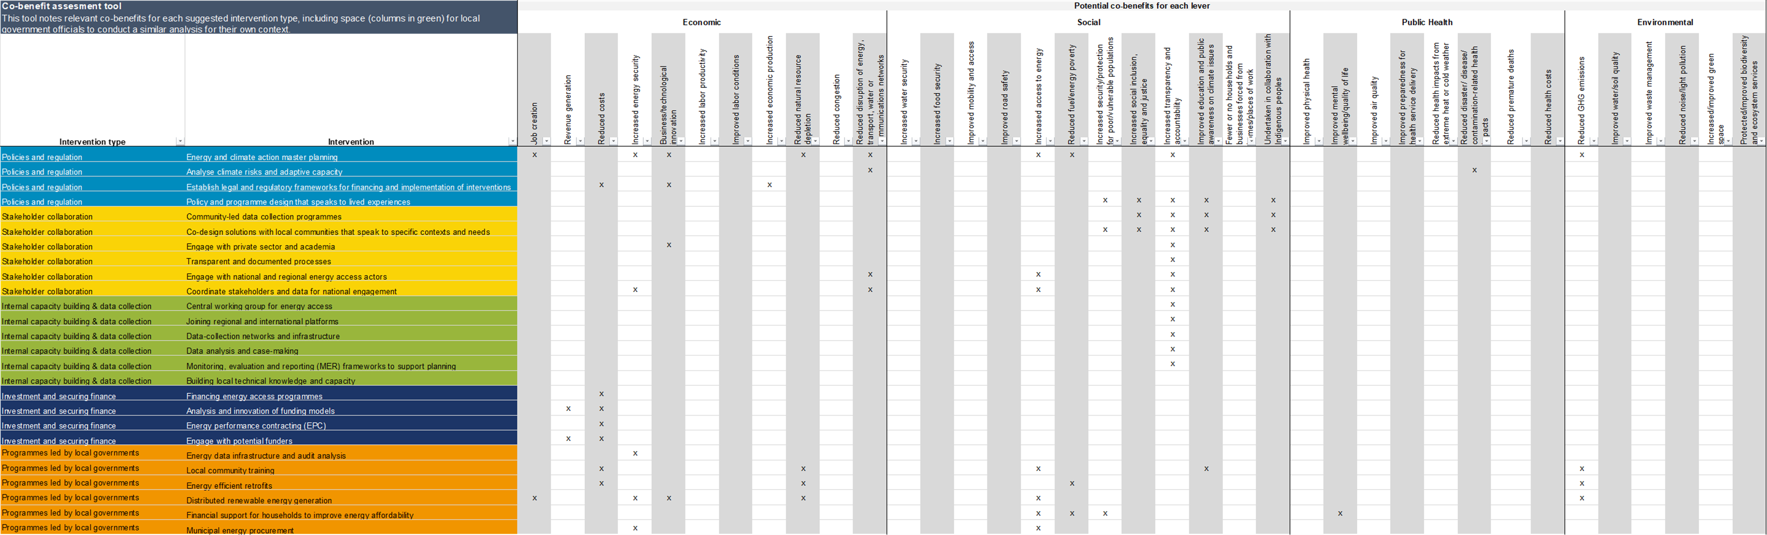
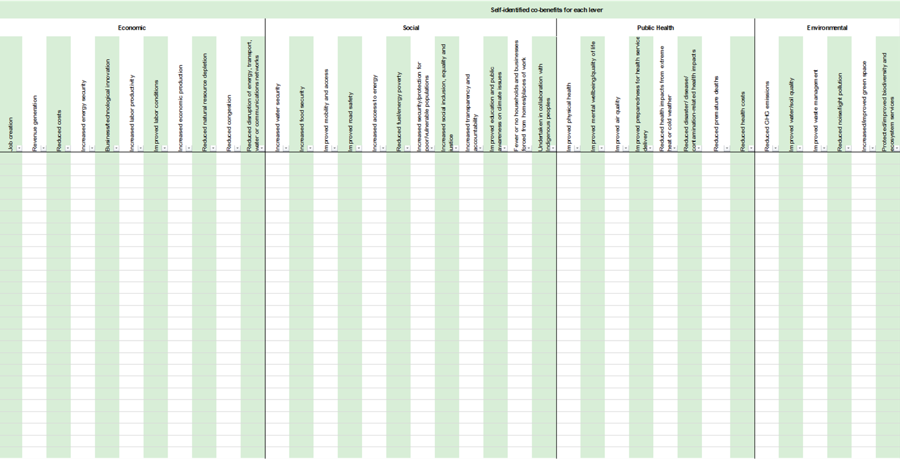
Tool & facilitation guide
Co-benefits assessment tool
Module 8 – Making the case for Energy Access
Use these grey columns to filter and review suggested co-benefits for specific interventions
The co-benefit categories listed are those used in CDP-ICLEI Track reporting.
The list of interventions are the same as those listed in Module 7, from previous research in 2023
These green columns at the end of the sheet are editable for your local analysis!

Slide 105
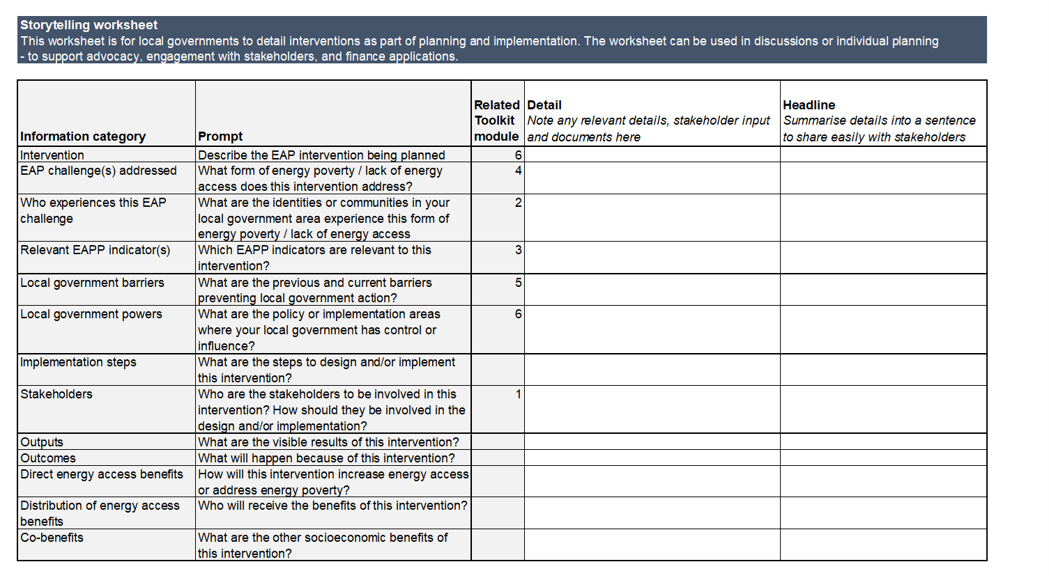
Tool & facilitation guide
Storytelling worksheet
Module 8 – Making the case for Energy Access
This worksheet is meant for one single action at a time!
Respond to each information category and prompt to define the action
Write a short headline that
can be easily communicated to and understood by external stakeholders
This can be used as an action planning worksheet, and also a database to extract relevant information to communicate with stakeholders

Slide 106
Health-check worksheet
Making the case for Energy Access
Module 8 – Making the case for Energy Access
What are the outcomes of energy access action in my local government?
What are the direct outcomes?
Which community groups receive
these outcomes & benefits?
Are there any other benefits related to emissions reduction, climate adaptation, or other forms of deprivation?
Governance and regulation needed to encourage
these outcomes and benefits
Data and monitoring needed to encourage
these outcomes and benefits
Notes:
Identify which national, regional, municipal and community partners are relevant
Compare groups that are most involved against groups that should be given space to participate and lead levers/solutions

Slide 107


www.globalcovenantofmayors.org
info@globalcovenantofmayors.org
GCoM Energy Access and Poverty Pillar Subcommittee Members
GCoM Regional and National Covenants

